Slide 1
Introduction
to
Neo4j
V 1.1

Slide 2
Introduction to
Graph Theory
Notes:
In this lesson, we will discuss some of the basic concepts in Graph Theory. This will provide useful context for understanding Graph Databases and Neo4j.

Slide 3

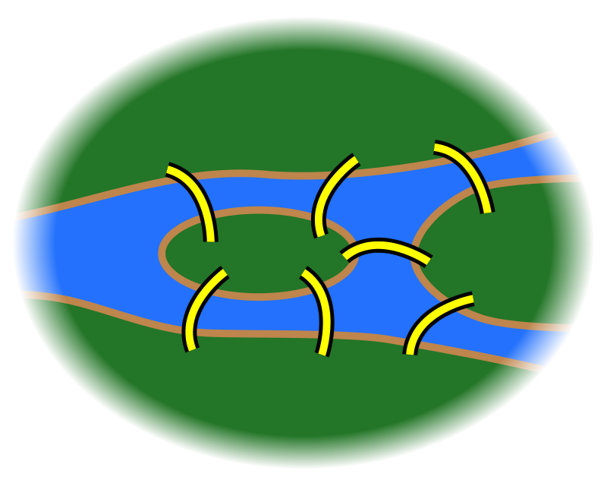
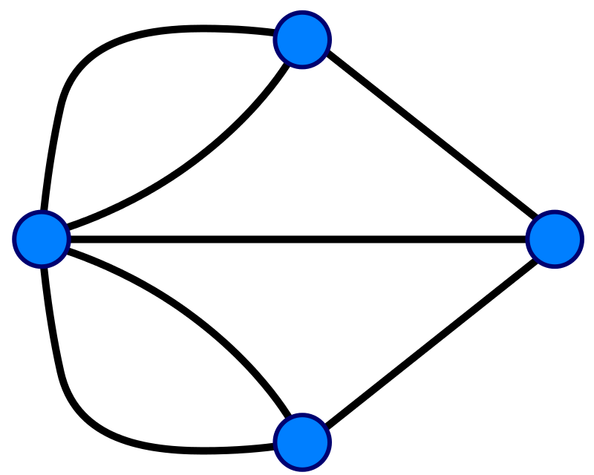
What is a Graph?
A graph is set of discrete objects, each of which has some set of relationships with the other objects
Seven Bridges of Konigsberg problem. Leonhard Euler, 1735
Notes:
First of all: what is a graph? A graph is a collection of objects, each of which has a set of binary links with the other objects. Graphs are a useful way to model data for the purposes of mathematical analysis, and they have been around for quite a long time. The first use of graphs was by Leonhard Euler in 1735; he used graph theory to prove that the famous Seven Bridges of Konigsberg problem had no solution. If you’re curious, we can talk about the Seven Bridges problem and Euler’s proof, but this is all deep background for the main topics of interest.
************************************************ ***** Optional: What is the Seven Bridges problem? *****
Konigsberg, Prussia (now Kaliningrad, Russia) is a city spanning the Pregel River. It includes two large islands, which are connected to one another and to the river banks by seven bridges. A map of this arrangement is pictured on the left. The Seven Bridges problem is this: is there any possible route through the city that crosses every bridge exactly once?
Some pen-and-paper experimentation will quickly suggest that there is no such route. However, PROVING that there is no solution is much more difficult; Euler invented Graph Theory as a tool to aid this proof. The graph representation of the problem is on the right: four landmasses, each represented by a node, and seven bridges, each represented by a relationship
************************************************ ****** Extra Optional: What was Euler’s proof? ********
Euler observed the following:
The route taken within each landmass is irrelevant. Only the sequence of bridges crossed matters.
Whenever you enter a landmass via a bridge, you must leave it by a different bridge
...except at the start (where you leave but do not enter) and at the end (where you enter but do not leave)
Ergo, for the problem to be solvable, every landmass (except the start and end) must be touched by an even number of bridges
Based on the above observations, the problem has no solution, because all four of the landmasses are touched by an odd number of bridges.

Slide 4
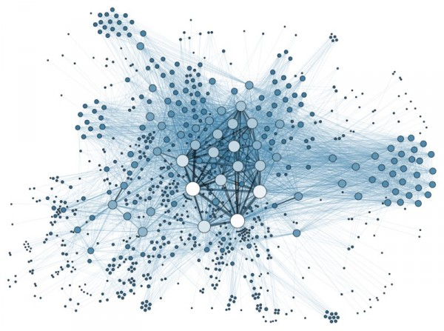
Anything can be a graph
the Internet
a water molecule
H
H
O
Notes:
But if graphs are an abstract mathematical tool, why do we care about them? We care because any dataset can be represented as a graph. Any structure or concept, no matter how simple or complex, can be broken down into a set constituent parts that have some relationship to one another. For example, the internet can be modeled as a network of computers. At the other extreme of complexity, a single molecule can be represented as a graph of its constituent atoms--or an atom represented as a graph of subatomic particles. And, as Euler showed, there are some clear benefits to representing data in this way. We will discuss many of these as we go. But mainly, graphs are uniquely useful when answering a question that involves following a path along a chain of related items. You will frequently hear Neo4j people refer to such questions as graph problems--and they are surprisingly common in the real world.

Slide 5
Graph Concepts
Notes:
Next, let’s discuss some of the core concepts of graph theory.

Slide 6
Graph Components
Node (Vertex)
The main data element from which graphs are constructed A node without relationships is permitted. A relationship without nodes is not.
A waypoint along a traversal route
Relationship (Edge)
Jane
car
Notes:
We will begin by defining the components that make up a graph. There are two of them: Nodes and Relationships. Note that these are the Neo4j terms for these objects; the original mathematical terms are Vertex and Edge. We’ve chosen our nomenclature because it more intuitively describes what the objects represent.
---------
First, let’s define a node. Nodes are the main objects of a graph. We say this not because nodes contain more data than relationships--although they usually do--but because it is perfectly acceptable to have nodes without any relationships. Conversely, is is not possible to have a relationship without any nodes. Mathematically, a node is defined as “a point where two or more edges (relationships) meet.” This is not at all intuitive! However, it provides important insight into how graphs are used. Since the entire point of modeling data as a graph is to traverse a chain of linked nodes, one useful way of thinking about nodes is that they are waypoints along the traversal route. They contain information you need to decide which links are good ones to follow, and which should be ignored. Relationships are those links.

Slide 7
Graph Components
Node (Vertex)
The main data element from which graphs are constructed A node without relationships is permitted. A relationship without nodes is not.
A waypoint along a traversal route
Relationship (Edge)
A link between two nodes. May contain:
Direction
Metadata; e.g. weight or relationship type
Jane
car
OWNS
Notes:
Next, let’s define a relationship. Relationships are the links between nodes. In their simplest form, relationships need not contain any information other than which two nodes they link. But they can (and in Neo4j always do) contain much more. For example, relationships can include a direction. “Jane owns a car” is a very different relationship than “ A car owns Jane,” and the direction of the relationship between Jane and her car captures this. Relationship directions are required in Neo4j. In addition, relationships can contain any amount of additional metadata, such as weight or relationship type. For example, the relationship between Jane and her car is of the type OWNS. Like direction, Type is a required element of Neo4j relationships, although all other metadata is optional. ---------- In Neo4j, the purpose of the data attached to a relationship is to reduce the need to “gather and inspect,” where you follow all relationships from a given node, then scan the target node data to determine which hops were “good” ones and then discard the rest. This does not scale well. Instead, we can use the metadata attached to a relationship to preemptively filter which links to follow during traversal.

Slide 8
Traversal
Walk: an ordered, alternating sequence of nodes and relationships Nodes and relationships can be repeated
1
3
2
4
6
5
1-2-3-2-6-2
Notes:
In addition to these basic graph components, one vital concept within graph theory is Traversal. As mentioned before, the main point of graphs is to follow a chain of nodes and relationships; the process of finding such routes is the definition of traversal. This is a fairly straightforward concept, but for the sake of clarity and precision, we will take a moment to discuss the different ways a graph can be traversed. Broadly speaking, there are three kinds of traversals: Walks, Trails, and Paths. A Walk is the most basic of these. It is simply an ordered, alternating list of nodes and relationships. For example, in this simple graph, we could define a walk starting at node 1, then hopping to 2, then 3, back to 2, onward to 6, and back to 2. There are no restrictions here; you can use relationships multiple times, and visit the same node as many times as you wish.

Slide 9
Traversal
Walk: an ordered, alternating sequence of nodes and relationships Nodes and relationships can be repeated
Trail: A walk in which no relationships are repeated Nodes can be repeated
1
3
2
4
6
5
1-2-3-2-6-2
1-2-6-2
Notes:
Next is a Trail, which is somewhat more restricted. A Trail is a walk in which no relationships are repeated. You can still visit a node as many times as you want, but each link can only be used once! For example, remember the Seven Bridges problem? The desired traversal in that case is a trail. You can visit each landmass as many times as you like, but can only cross each bridge once. By contrast, the walk we just performed (1-2-3-2-6-2) is not a valid trail, because we traversed the relationship between 2 and 3 twice. Instead, a valid trail could start at 1, then go to 2, 6, and back to 2. This is permitted because there are TWO relationships between 6 and 2, and we use each of them once.

Slide 10
Traversal
Walk: an ordered, alternating sequence of nodes and relationships Nodes and relationships can be repeated
Trail: A walk in which no relationships are repeated Nodes can be repeated
Path: A trail in which no nodes are repeated I.e., a walk where all items are unique
1
3
2
4
6
5
1-2-3-2-6-2
1-2-6-2
1-2-6
Notes:
Finally, we have a Path.
A Path is a trail in which no nodes are repeated. Stated another way, a Path is a walk in which all items are unique, nodes and relationships both. The trail we just followed (1-2-6-2) is not a valid path because it visits node 2 twice. Drop that last hop, and this becomes a valid path.
-------
The problems we solve with Neo4j almost exclusively involve traversing Trails and Paths. I mention walks not because you will use them, but to stress that the term path means something very specific in the context of graphs, and the implications are important. For example, there are several special kinds of paths that are extremely useful for solving certain problems. Shortest path (the path containing the fewest elements) is the most common of these. More esoteric examples include Longest path, Hamiltonian path (visits every node in the graph), Cycle (“path” that ends at the same node it started on), and so on. Using any of these requires a strong understanding of paths. ****** In case someone asks for more details ***** Technically speaking, Neo4j exclusively traverses Trails, even though the in-product term is “path”. You can further ensure uniqueness of nodes using a complex WHERE clause (not recommended), or by using the APOC plugin, which includes a parameter for node uniqueness. There are a few reasons for this design.
------
First: Why permit Trails, but not Walks? The reasoning here is both practical and technical. Practically, the vast majority of real-world problems are solved without retracing steps. Uniqueness is a highly salient concept in everyday human thinking, and Trails maintain that in the context of relationships. Walks are often used by mathematicians, but few other people. Technically, allowing repeated relationships runs the risk of infinite-looping in a data model that contains closed cycles.
-------
Second: If uniqueness is so important, why does Neo4j use Trails instead of Paths? TBD

Slide 11
Summary

Slide 12
Summary
A graph is a data model consisting of a set of nodes linked by relationships
The purpose of modeling data as a graph is to enable traversal
There are multiple traversal types, the most important of which is a path an ordered, alternating set of nodes and relationships in which all items are unique

Slide 13
Graph Databases &
Index-Free Adjacency
Notes:
In this lesson, we will one of the central concepts that distinguishes graph databases from other database paradigms: Index-Free Adjacency. That may sound strangely complex and technical for an introductory course, but we’re talking about it now because the effects of it are immense and far-reaching. So if we can establish a solid understanding of Index-Free adjacency now, we will save ourselves a great deal of headache and potential confusion later.

Slide 14

IFA in 2 Minutes
My house
Anne’s house
Source: https://medium.com/@dmccreary/how-to-explain-index-free-adjacency-to-your-manager-1a8e68ec664a
Notes:
Let us begin by making a real-life analogy. Suppose you bake a pie for your friend Anne. You want to delivery it quickly, so she can enjoy it while it is still warm. How would you go about delivering it? Most people would follow these simple steps:
Leave my house
Point myself towards Anne’s house
Walk to Anne’s house
This takes maybe 30 seconds, and the pie is piping hot when you get there. No wasted time or effort. This is how Index-Free adjacency operates.

Slide 15
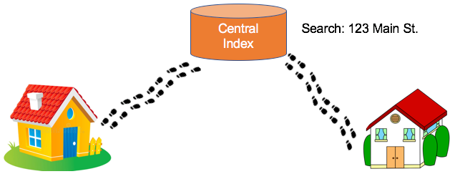
IFA in 2 Minutes
My house
Anne’s house
Notes:
By contrast, traditional RDBMS cannot do this. In a RDBMS world, the pie-delivery process would go like this:
Leave my house
Walk to the town hall. It contains a Central Index containing the addresses of everyone in town.
Stand in line. Everyone looking for an address needs to do the same thing you are, so there is a wait.
Tell the search agent whom you’re looking for. They will look up Anne’s address in the index (note that the larger the town, the longer it takes to do the search). The agent gives you Anne’s address.
Enter the address into the map app on your phone, and follow the directions to Anne’s house
This is obviously inefficient. You needed to walk twice as far, had to wait in line, and had to wait for a search process to complete But to make matters even worse, there is no concept of “learning the route,” no matter how many times you take it. Every single time you want to visit Anne’s house, you need to follow these same steps!

Slide 16
The Relational Data Problem
Notes:
That story gives a quick view of the difference, but it is worth our while to look at the details of this in brief. We’ll start by looking at the weaknesses of RDBMS with relational data.

Slide 17
Relationships in RDBMS
Require foreign keys, and possibly a lookup table
Traversing a foreign key requires an index lookup
The purpose of graphs is to do rapid traversal. The RDBMS model is too expensive for that.
Person
ID | Name
1 | Anne
2 | James
3 | Alex
Lookup
Person | Address
1 | 2
2 | 2
3 | 1
Address
ID | Country
1 | Germany
2 | USA
Notes:
In RDBMS, the links between records are defined using foreign keys in lookup tables. These lookup tables are the Central Index from our analogy. In order to link from one record to another, you need to capture the ID of the person you’re interested in, find their entry in the lookup table, capture the foreign key for their address, then find the matching primary key in the Address table. That is 4 tasks to complete the very simplest operation. Even if all of these tasks are perfectly optimized (which is almost never the case in real life), these inefficiencies will add up quickly. Recall graph problems involve traversing many links along a path--sometimes dozens or hundreds or thousands or even more. Multiply each of those hops by 3-4 tasks, and even the very fastest process will slow to a crawl.
Index-Free Adjacency has two main purposes:
Reduce this 4-part process to a single step
Eliminate the need to do index lookups. These can get very costly when data volumes are large

Slide 18
Index-Free Adjacency
Notes:
Next, let’s examine how Index-Free Adjacency enables rapid traversal, and some of the additional effects that appear when we implement it

Slide 19
IFA Benefits
IFA uses pointers to the target address
1
2
3
4
5
Anne
Links | 5
USA
Links | 3
Alex
Links | 2
James
Links | 5
Germany
Links | 1, 4
No index lookups or table scans
Reduced duplication of foreign keys
Notes:
The most important way that Index-Free Adjacency differs from traditional RDBMS is in how relationships are expressed. Instead of using a Document ID as a relationship key, objects are linked using pointers. In other words, rather than Person 1 (Anne) being linked to Address 1 (Germany), IFA would instead say that the item at location 1 (Anne) is linked to the item at location 5 (Germany). This immediately eliminates 3 of the 4 steps in the RDBMS model. You still need to do some work to identify the starting point for traversal, but once you know which set of records to start from, hopping from one link to the next is a trivial matter of reading the location specified. No more lookup tables or index searches. As a side effect of this, one hidden benefit of IFA is potential data size reduction. Lookup tables and foreign keys are not heavy storage consumers by nature, but in a highly relational dataset--particularly one that is not especially well optimized--they can add up to a great deal of duplicated information. Index-free adjacency eliminates this.

Slide 20
IFA Question: Deletion
How to avoid wasted space on deletion and insertion?
1
2
3
4
5
A
B
C
D
6
7
8
9
10
E
F
G
H
J
Notes:
As great as index-free adjacency is for traversal, it does raise one common storage question: how to manage deletions and new writes without lots of wasted space?
Content items rarely have uniform sizes. Some are larger and some are smaller, and the disparity between the largest and smallest items can be extreme. Supposing we have a dataset like the one pictured here, what happens if we delete Item G? There is no guarantee that the next item we write to the database will be of EXACTLY the same size. If it is larger, it won’t fit, and will need to be written elsewhere. If it is smaller, we will have some extra space at the margins, which lessens the amount of waste but does not eliminate it. One common way of managing space during deletion and insertion is to occasionally defragment or “optimize” the database. This involves reorganizing items so that current items are stored maximally efficiently. But with IFA, because all relationships are expressed as concrete locations, defragmenting the storage system would require rewriting most (or even all!) of the relationship values. This can be enormously painful--especially in use cases where data writes and deletions are common and numerous.

Slide 21
IFA Solution: Chunking
All data objects are chunked into same-size pieces
1
2
3
4
5
A
A
B
C
D
6
7
8
9
10
C
E
F
C
F
Notes:
Neo4j uses a fairly common solution to this issue: data chunking. All data items, regardless of the size of their content, are stored in same-sized chunks. Any item that is too large for one chunk simply reserves multiple chunks for itself, as you see here with items A, C, and F. When you do this, the need for defragmentation vanishes. You can guarantee that any new data item will fit precisely into the spaces left from earlier deletions.

Slide 22
IFA Solution: Chunking
Related chunks need not be adjacent
e.g., a four-chunk object can use the first four open locations, no matter where they are
Related chunks reference one another via IFA
Effect: scanning for a value within a large data item can involve many “hidden” hops
Corollary: it is frequently cheaper to perform multiple relationship hops rather than scan for a value within a single large object
Corollary: in Neo4j, every object should store as little data as is feasible
Notes:
From a technical perspective, chunking in this way is uniquely suited to a traversal-centric data paradigm. The related chunks of a single data item need to be traversed in order to express their full contents; and, as we have already discussed, Index-Free Adjacency makes these kinds of hops quite cheap. What’s more, related chunks need not be adjacent in storage for their traversal to be fast. However, this model leads to a data modeling paradigm that is quite different from that used in RDBMS.
-------
In a traditional database, denormalization is a common strategy for increasing performance. This involves duplicating data from one table into another in order to reduce the need to perform traversals. As a side effect of that, there is a pervasive rule-of-thumb in the data management world that “it is more performant to store as much information as possible in a single record.” But in an IFA-driven, chunked data model, precisely the reverse is true. Because large data items are spread across many chunks, scanning a single item involves performing multiple hops. If the specific piece of metadata you’re interested in is located at the very end of the file, this traversal could be lengthy.
On the other hand, if the data is instead highly fragmented, and the relationships between the various parts of the data well-designed, you can skip from the first portion of a single data item to the last portion in 1-2 hops. Thus, It can be beneficial to model large data items as a network of related smaller items, as this results in fewer hops overall than scanning within a single large item. -------
The main takeaway here, though, is this. Because of the things we just discussed, the modeling rule-of-thumb in Neo4j is that each data item should store as little information as is feasible. This is precisely backwards from the denormalization-driven assumptions of the RDBMS world. Of course, this is not to say that your nodes and relationships should NEVER contain large amounts of data! That depends on your specific use case and dataset. This rule-of-thumb is mainly meant to to highlight the fact that one of the common assumptions of RDBMS data modelling absolutely does not hold in the context of Neo4j--and keeping that assumption can hurt you.

Slide 23
Summary

Slide 24
Summary
RDBMS is very inefficient at traversal
Foreign keys, lookup tables, and a four-step process are required
Index-Free Adjacency speeds traversal by using pointers instead of keys and lookup tables
Neo4j uses chunking to store data maximally efficiently
Because of this, all objects should store as little data as feasible

Slide 25
Introduction to
Neo4j

Slide 26
Overview
At the end of this module, you should be able to:
Describe the components and benefits of the Neo4j Graph Platform.

Slide 27

Neo4j Graph Platform
The Neo4j Graph Platform includes components that enable you to develop your graph-enabled application. To better understand the Neo4j Graph Platform, you will learn about these components and the benefits they provide.
The heart of the Neo4j Graph Platform is the Neo4j Database.

Slide 28
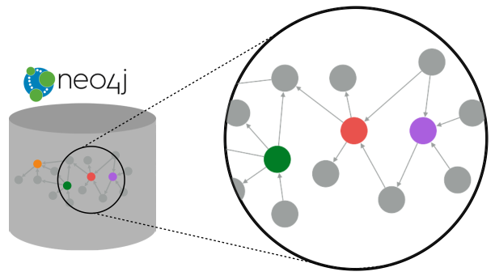
Neo4j Database: Index-free adjacency
Nodes and relationships are stored on disk as a graph for fast navigational access using pointers.

Slide 29
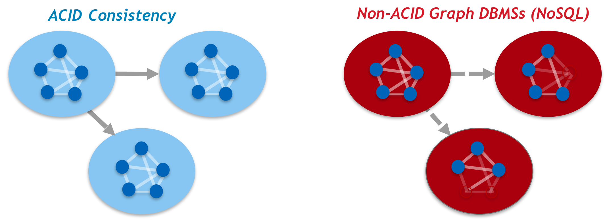
Neo4j Database: ACID
Transactional consistency - all updates either succeed or fail.

Slide 30
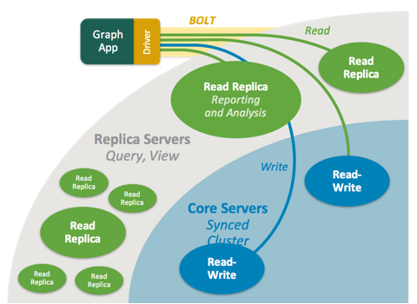
Clusters
ACID across locations.

Slide 31

Graph engine
Interpret Cypher statements
Store and retrieve data
Kernel-level access to filesystem
Scalable
Performant

Slide 32
Language and driver support
Cypher to access the database
Open source Cypher
You can write server-side extensions to access the database
Out-of-the-box drivers to access the database via bolt protocol:
Java
JavaScript
Python
C#
Go
Neo4j community contributions for other languages

Slide 33
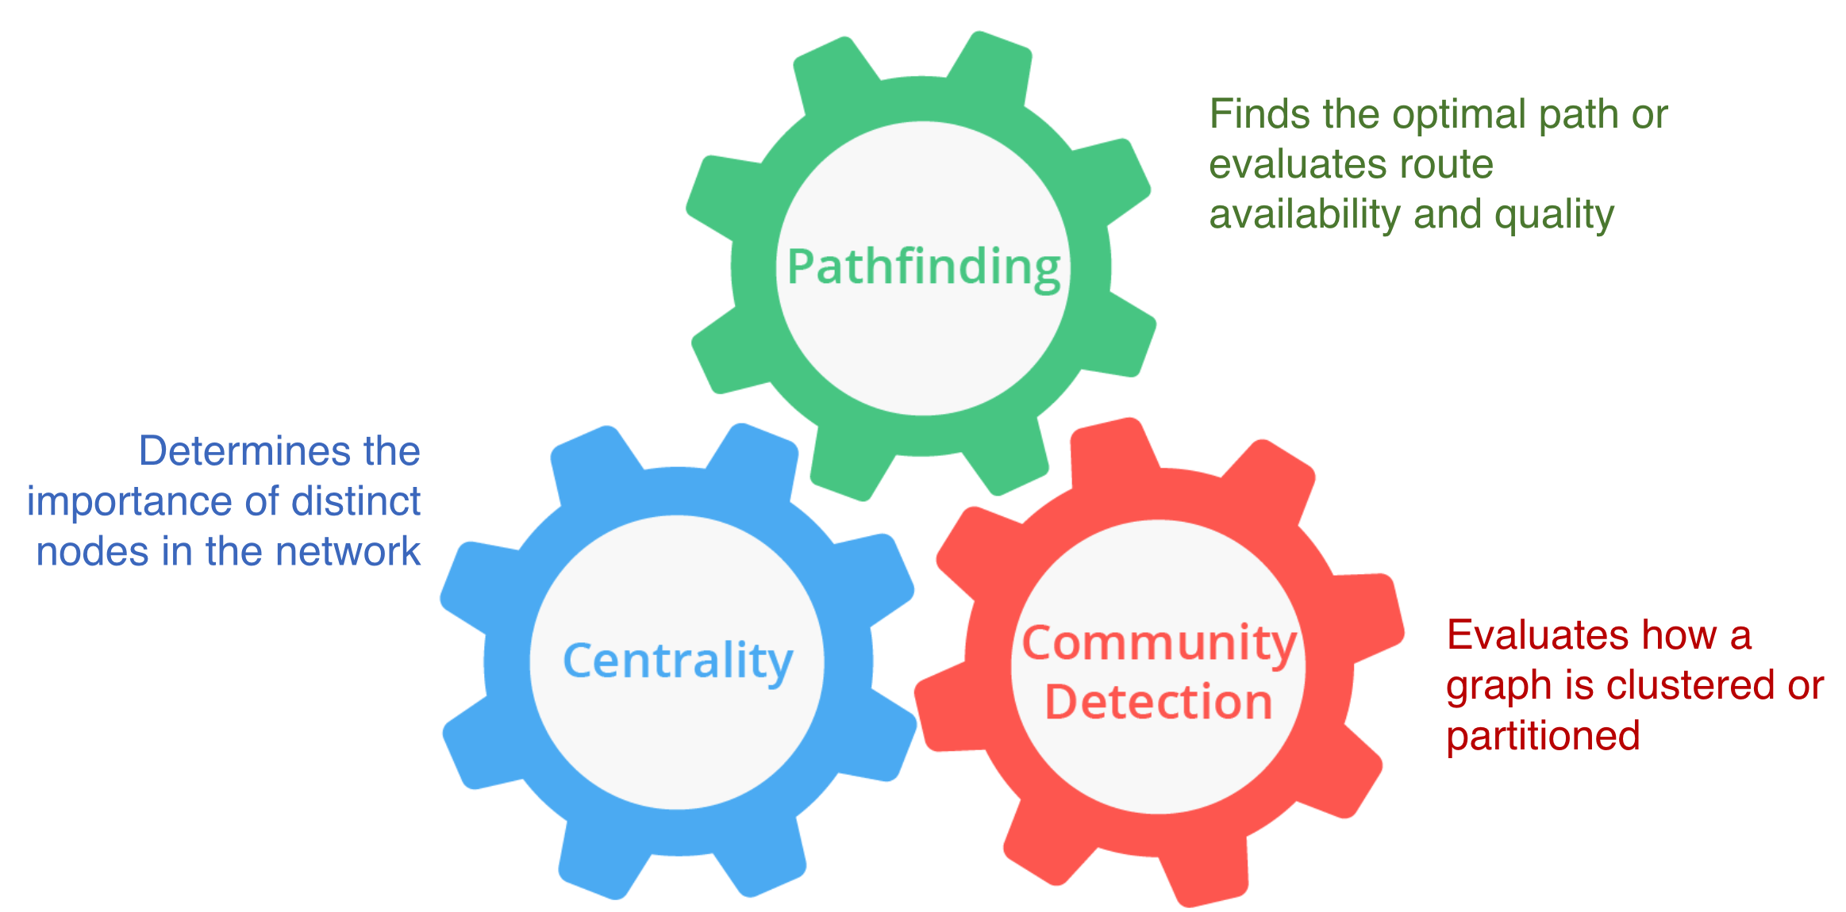
Libraries
Out-of-the-box:
Awesome Procedures on Cypher (APOC)
Graph Algorithms
GraphQL
Neo4j community has contributed many specialized libraries also.

Slide 34
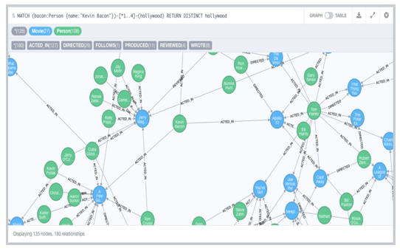
Tools
Neo4j Desktop
Neo4j Browser
Neo4j Bloom
Neo4j ETL Tool
Neo4j community has contributed many specialized tools also.
Notes:
If you have it, you could do a demo of Bloom to wow the students.

Slide 35
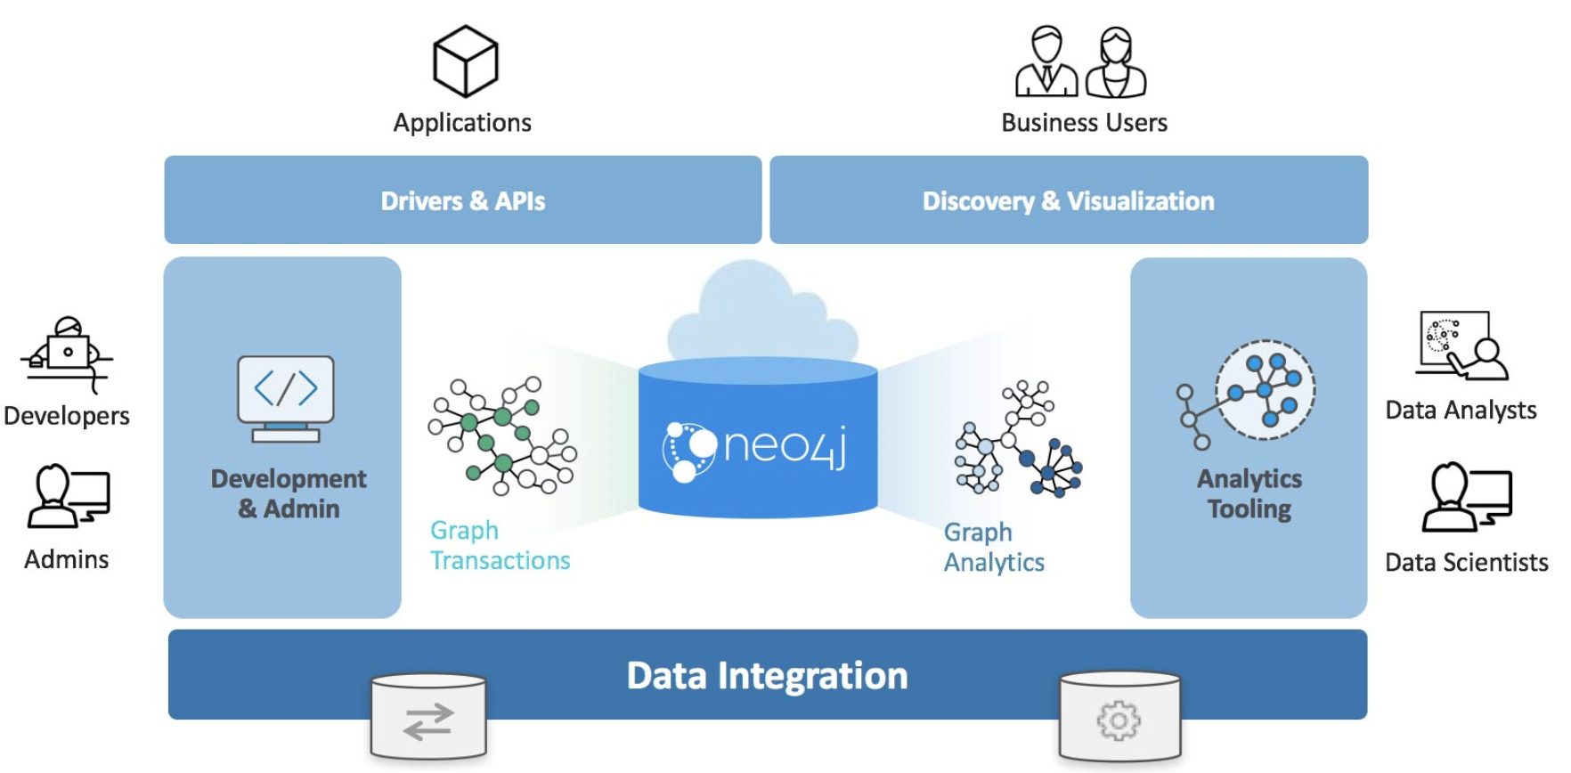
Neo4j Graph Platform architecture

Slide 36
Check your understanding

Slide 37
Question 1
What are some of the benefits provided by the Neo4j Graph Platform?
Select the correct answers.
❏ Database clustering
❏ ACID
❏ Index free adjacency
❏ Optimized graph engine
Notes:
What are some of the benefits provided by the Neo4j Graph Platform?
Select the correct answers.
✅ Database clustering
✅ ACID
✅ Index free adjacency
✅ Optimized graph engine

Slide 38
Answer 1
What are some of the benefits provided by the Neo4j Graph Platform?
Select the correct answers.
✅ Database clustering
✅ ACID
✅ Index free adjacency
✅ Optimized graph engine

Slide 39
Question 2
What libraries are included with Neo4j Graph Platform?
Select the correct answers.
❏ APOC
❏ JGraph
❏ GRAPH ALGORITHMS
❏ GraphQL
Notes:
What libraries are included with Neo4j Graph Platform?
Select the correct answers.
✅ APOC
❏ JGraph
✅ GRAPH ALGORITHMS
✅ GraphQL

Slide 40
Answer 2
What libraries are included with Neo4j Graph Platform?
Select the correct answers.
✅ APOC
❏ JGraph
✅ GRAPH ALGORITHMS
✅ GraphQL

Slide 41
Question 3
What are some of the language drivers that come with Neo4j out of the box?
Select the correct answers.
❏ Java
❏ Ruby
❏ Python
❏ JavaScript
Notes:
What are some of the language drivers that come with Neo4j out of the box?
Select the correct answers.
✅ Java
❏ Ruby
✅ Python
✅ JavaScript

Slide 42
Answer 3
What are some of the language drivers that come with Neo4j out of the box?
Select the correct answers.
✅ Java
❏ Ruby
✅ Python
✅ JavaScript

Slide 43
Summary
You should be able to:
Describe the components and benefits of the Neo4j Graph Platform.

Slide 44
Setting Up Your
Development Environment

Slide 45
Overview
At the end of this module, you should be able to:
Determine your ideal Neo4j development environment
Start using Neo4j Desktop / Neo4j Sandbox
Start using Neo4j Browser

Slide 46
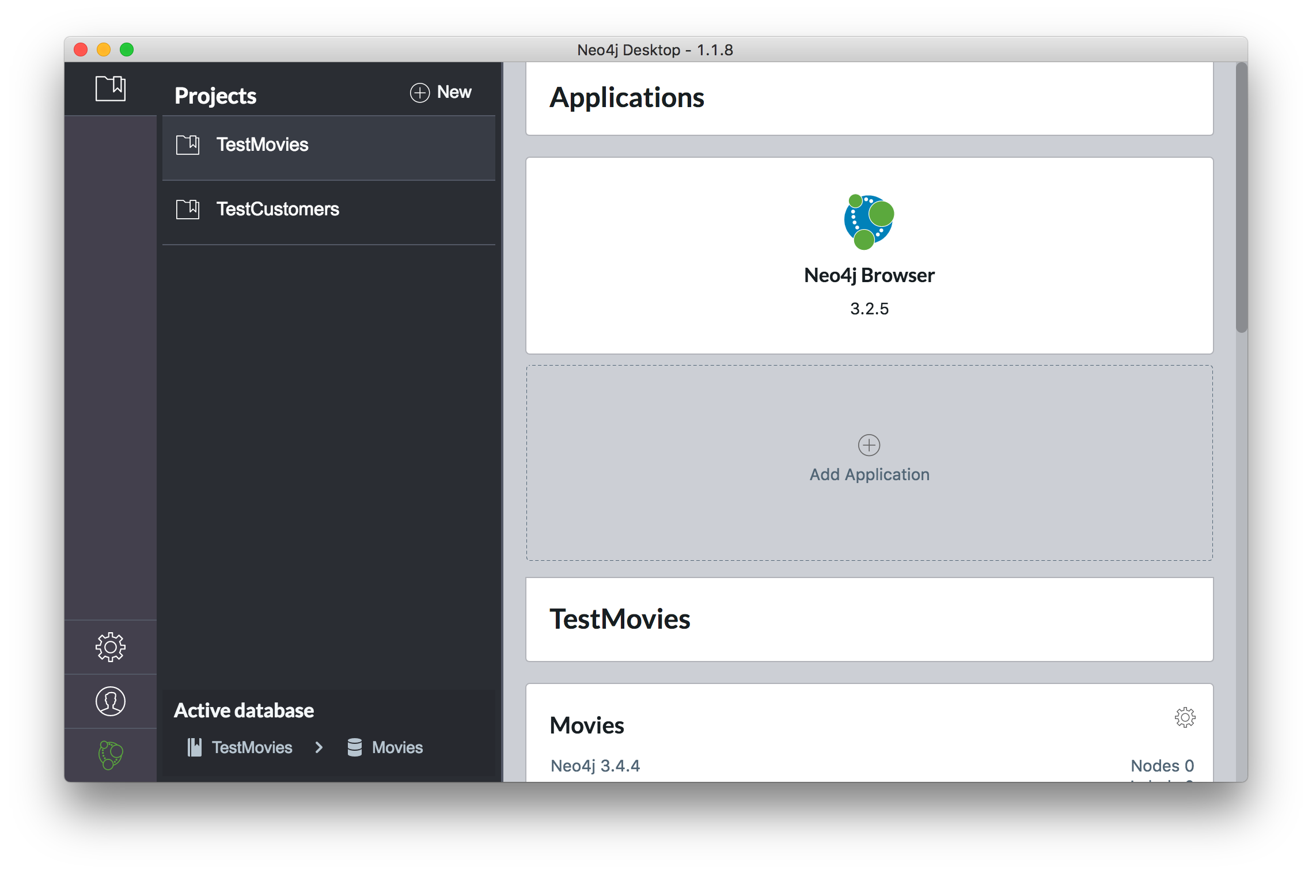
Neo4j Desktop
Create local databases
Manage multiple projects
Manage Database Server
Start Neo4j Browser instances
Install plugins (libraries) for use with a project
OS X, Linux, Windows

Slide 47
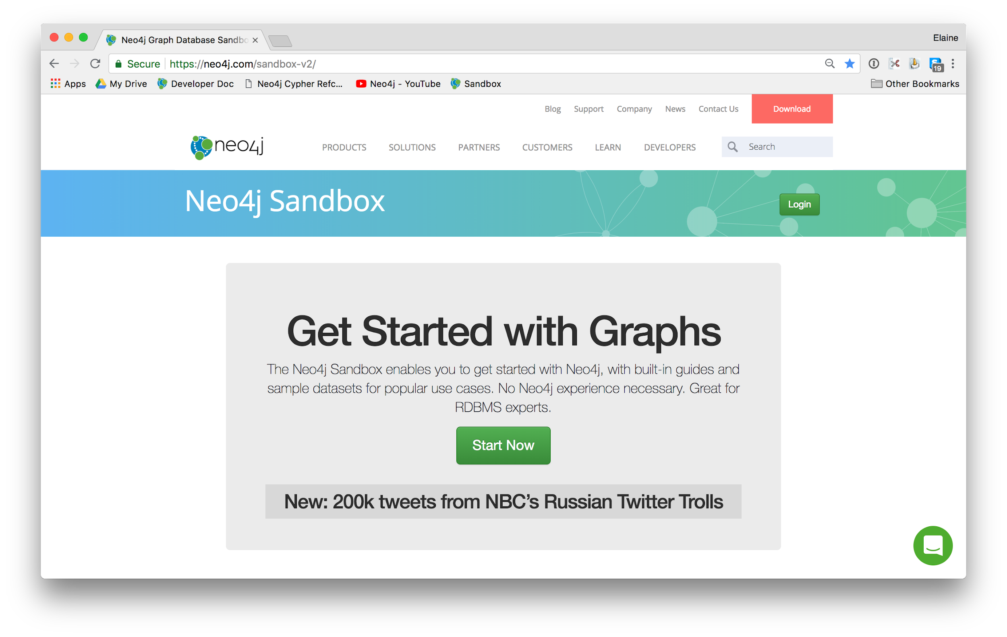
Neo4j Sandbox
Web browser access to Neo4j Database Server and Neo4j Database in the cloud
Comes with a blank or pre-populated database
Temporary access
Save Cypher scripts for use in other sandboxes or Neo4j projects
Instance lives for up to ten days
No need to install Neo4j on your machine
Notes:
Skip this slide if nobody is using Sandbox

Slide 48
Setting up your development environment
If using Neo4j Sandbox:
Start a Neo4j Sandbox (use latest Neo4j release).
Has a blank database that is started.
Click the link to access Neo4j Browser.
If using Neo4j Desktop:
Install Neo4j Desktop.
In a project, create a local graph (database).
Start the database.
Click the Neo4j Browser application.

Slide 49
Guided Exercise: Getting Started with Neo4j Desktop
Note: You must either install Neo4j Desktop or create a Neo4j Sandbox to perform the hands-on exercises.
Notes:
A Guided Exercise means that you do the steps and the students follow along and perform the same steps on their laptops.
Some students may choose to use a Neo4j Sandbox. They need not follow along on their laptops since they will not be installing the Desktop.
----
Here is the video if you want to view it on your own, but you should perform the steps if possible in front of the class:
https://youtu.be/8yWhuUnPapw
Here is the script of the video if you want to replicate the steps of the video:
In this video, I am going to show you how easy it is to download, install, and start using the Neo4j Desktop.
You go to the Neo4j Web site.
At the top, you click the download button which brings you to the download page.
You want to install the Desktop, so you click the big button here for downloading the Desktop.
At this point, you must provide Neo4j with some identifying information before you can begin the download.
So we do that and we click Download Desktop.
Now it detects what kind of system you are on and it presents you with a page with the installation and getting started with the Desktop guide which we will be going through in this video.
Once the download completes, you simply click the installer.
The installer asks you to move it to your Applications folder on the MAC.
Once that is done, you simply go to the Applications folder and you open the Desktop.
There are some preliminary questions you must answer when you first open the Desktop, the license agreement, and if you have an activation key. We are just going to be using the evaluation version right now. Anonymous reporting is a good thing so click that.
Here we are in the Desktop.
The Neo4j Desktop is where you manage your projects, your databases, and the settings you use at runtime.
The settings view allows you to change some switches about your particular environment, including proxy settings.
The user profile is where you would enter your activation keys.
And this is simply the version of the software.
The projects view enables you to define a project for accessing a particular graph or database.
So you have a graph which is your database, and optionally you can install plugins that will work in your application environment for this database.
We’re going to change the name of the project. Give it a name called TestMovies and then, we are going to want to create our first graph.
In the beginning, you will be creating a local graph.
You must provide a password that you remember because you might be accessing the database from your application.
And the graph is created. From this window you can either manage or start the database.
If we click the manage button, it gives you information about the database. It’s currently not running.
The settings page allows you to view and modify the configuration information for your particular project.
We click the start button to start the database.
And here we see that the database is now active in the TestMovies project.
You can stop the database by simply clicking the stop button.
And here we’re going to see that we no longer have an active database.
We don’t like the name graph, so we are going to customize the name of our database in this Desktop to be Movies.
And now, we’re going to want to start the database again. So we start the database and it’s started.
Here in the manage area, we see that our database is running for this project.
The bolt port is a very important port. That’s the port that is used for binary communication to access the database from applications and from the Neo4j Browser application.
The HTTP port is used for accessing the Web interface to the Neo4j Browser.
Here we see in the logs that our database is started. So this is where you would look for information about problems with accessing the database.
Now in the project view, we see that we have one project, but we want to add a new project.
We’re going to call this project TestCustomers.
When we create the project, we will have our own graph that is used for this project.
We enter the password.
At this point, we want to change the name of the database from graph to customers.
So now we have two projects, each with their own graph. And we see that the Movies database is currently running. In the Desktop, you can only have one database active at a time.
So we are going to stop the Movies database, and then we can start the TestCustomer’s project’s database, which is called Customers.
Now we see that we have our Customers database that is started and can be used from the TestCustomers applications.
So that’s all you need to do to get started with the Neo4j Desktop.

Slide 50
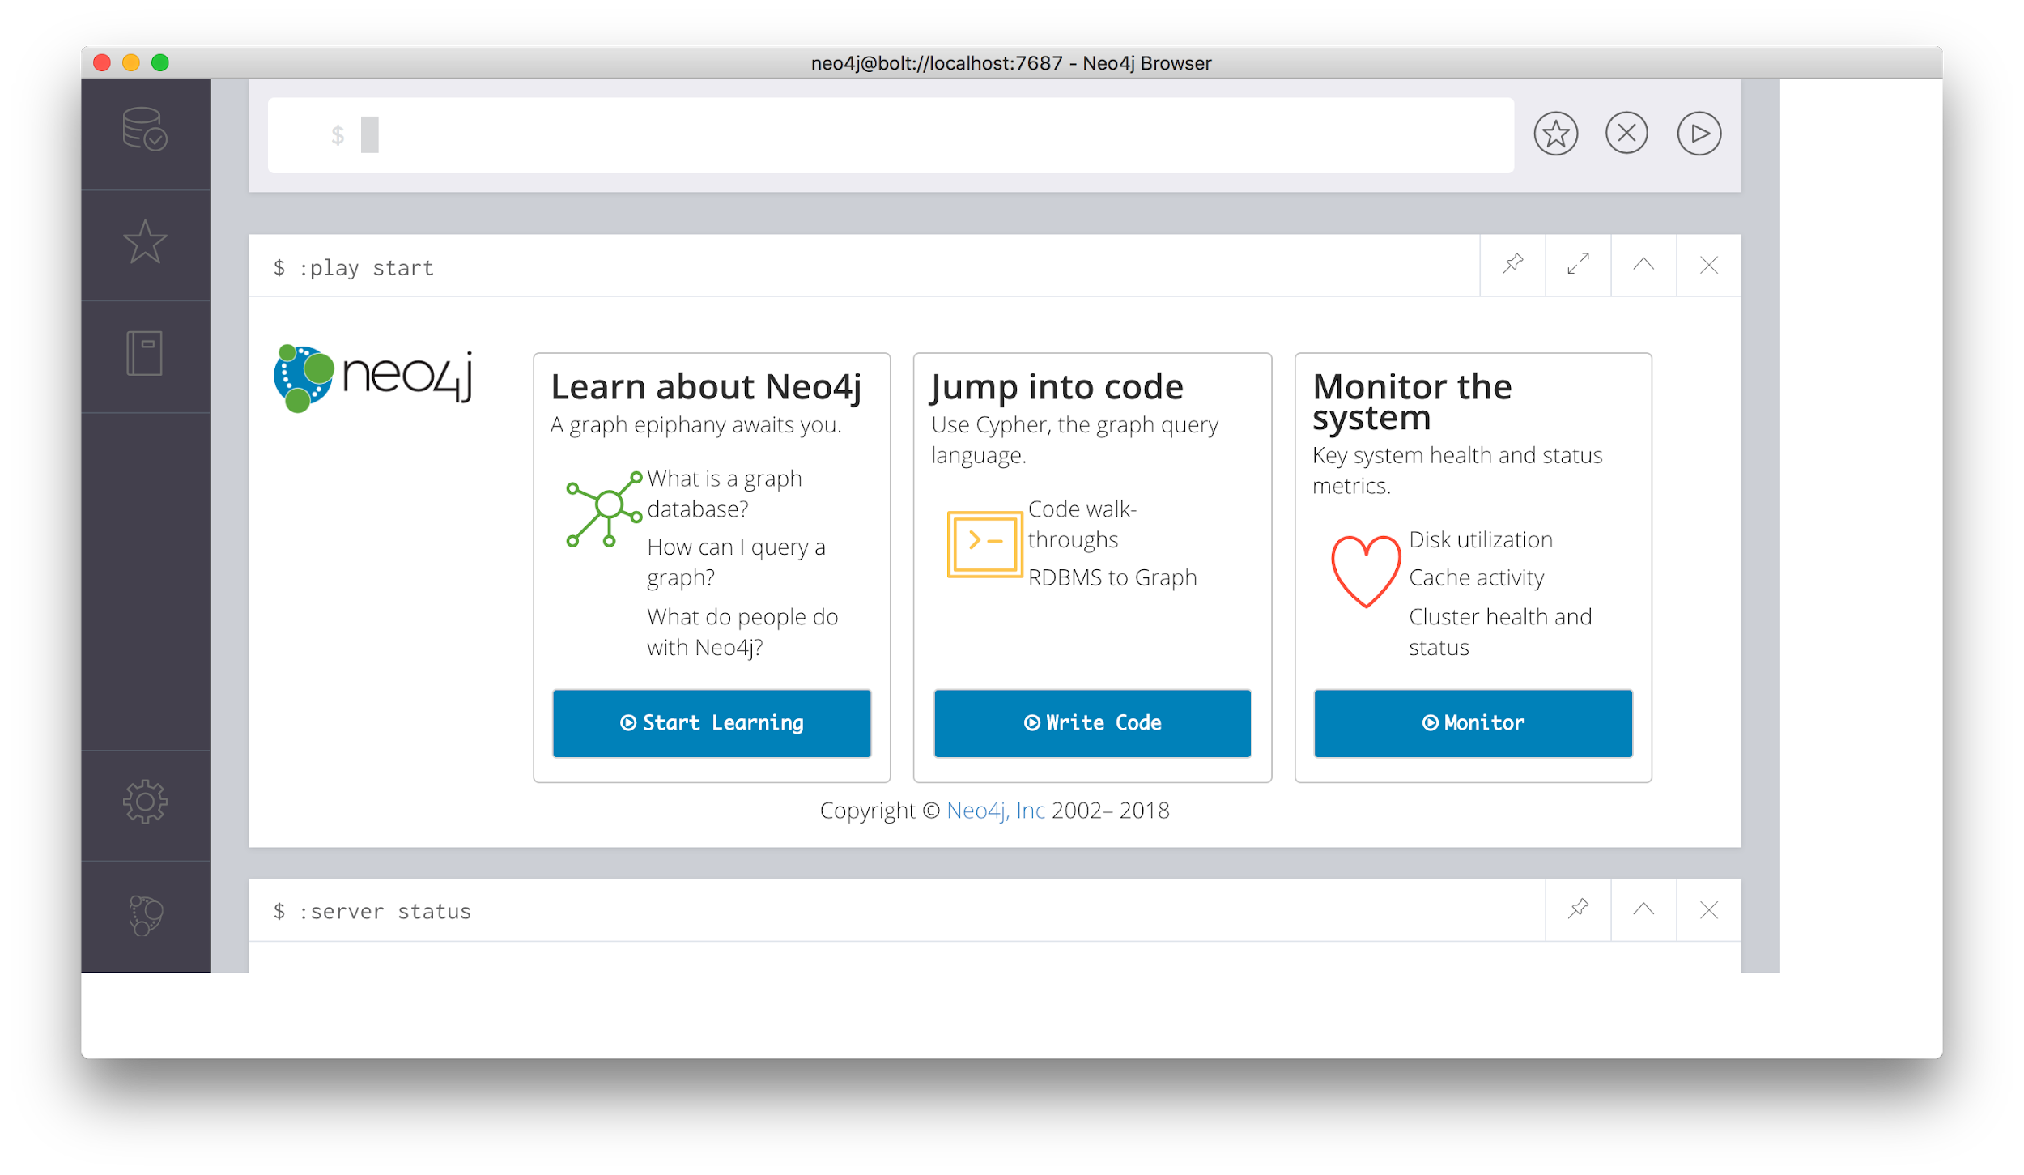
Neo4j Browser
Web browser access to Neo4j Database Server and Neo4j Database
Access local database (Neo4j Desktop) or database in the cloud (Sandbox)
Access the database with commands or Cypher statements

Slide 51
Guided Exercise: Getting Started with Neo4j Browser
Note: You must have created a Neo4j Database locally or a Neo4j Sandbox to begin using Neo4j Browser. In this exercise, you will populate the database used for the hands-on exercises.
Notes:
A Guided Exercise means that you do the steps and the students follow along and perform the same steps on their laptops.
This is a LONG Guided Exercise, but an important one as it introduces the students to using the Neo4j Browser effectively.
During this Guided Exercise, the students will populate the database which is an important step prior to any hands-on exercises.
----
Here is the video if you want to view it on your own, but you should perform the steps in front of the class:
https://youtu.be/rQTximyaETA
Here is the script of the video if you want to replicate the steps of the video:
In this video, I am going to show you how to use Neo4j Browser in your development environment.
If you are using the Neo4j Desktop, you can start the Neo4j Browser application from the project, provided the database for that project has been started.
You simply click on the Neo4j Browser icon here in the applications area to start it.
Recall that when you start the Neo4j database, it provides you with information about the ports for accessing the database. The HTTP port on a local server is used for accessing the Neo4j Database from a Web Browser.
In our Web browser, we simply specify localhost with the port, 7474 to access the database.
Notice that the UI for the Neo4j Browser application and the UI for the Web browser interface if pretty much identical. The only difference is the cloud area here which you will learn about later in this video.
You can also access the database running in a Sandbox by navigating to the Sandbox and clicking the link for the browser.
For this video, I will use the Web browser interface to the Database that is running locally.
In Neo4j Browser, you have various settings and information on the left that we will learn about later in this video after you have seen how to execute some commands and Cypher statements in the Browser.
On the right, we have two panes. The top pane is used for editing and running Browser commands and Cypher statements. The pane below the top pane is the result pane. This is where the results of the most recently executed command or Cypher statement are shown.
Notice that here, when we access the database for the first time, the command :play start is executed. A command begins with a colon. A Cypher statement does not.
We type the command :help commands and press the enter or return key. This executes the command and displays the result in the newly created result pane.
If we type :help keys, information is displayed in the result pane about keyboard shortcuts.
You can see quick help on Cypher keywords. A very common Cypher keyword you will use is the MATCH keyword for retrieving data from the graph. If we type :help MATCH, we see a brief description of the syntax for using this Cypher keyword.
The most recent result is always displayed under the edit pane.
The exception to this is if you pin the pane. If a pane is pinned, it will always stay at its position.
Let’s pin the pane with the result of executing :help MATCH.
Here we type a different command, :sysinfo. Notice that the result of executing this command is placed after the pinned pane.
Let’s unpin this pane and now execute the last command, :sysinfo again. You can use the ctrl/cmd+up/down arrows to select from the command and statement history. Here I am recalling the previously executed command. I can press the enter or return key, or I can select the run icon here to run that command.
The :history command will display all of the commands and statements that were entered and executed.
Rather than navigating up/down to find the command or statement you want to execute, you can simply click on a block shown in the history result.
When you do so, it brings the command or statement into the edit pane so you can optionally modify it and then execute the command or statement.
Here we recall the :help commands command and modify it in the edit pane to be :help server.
You can expand and collapse result panes.
You can also delete result panes if they are not useful to you.
A setting in the Browser that may be useful for you is the number of result panes to display and the size of the command/statement history.
You can adjust these here in settings where you can modify the maximum number of result frames and the maximum command or statement history to keep.
You click the settings icon to collapse that part of the display.
If you have many result panes displayed and you don’t want to manually delete them, you can use the :clear command to delete all of them.
Even though you have cleared all of the result panes, you still have access to your command or statement history.
Up to now, we have seen the execution of commands. Now let’s execute a Cypher statement to show you how the Neo4j Browser executes against the database.
When we first opened the Neo4j Browser, the first command to execute was the :play start command.
The :play command is used to execute a browser guide that can be used to step you through some content that may help you learn about Neo4j.
The :play movie graph command enables you to learn some things about Cypher using the movie database. For this demonstration, I will play the movies browser guide.
In a browser guide such as this, you can step through the pages of the guide.
Here on page 2 is what we are interested in. You have not learned Cypher yet, but this large code block can be used to populate the movie database. In many of the guides, if you simply click on the code block, the Cypher statements are then placed in the edit pane.
You need not understand this long block of Cypher code. We simply run this Cypher statement to load the movie database.
The Cypher statement executes and displays a graph containing some of the Person and Movie nodes that are connected by relationships.
When a Cypher statement returns a graph, it can be exported as an image or a CSV file.
This result is displaying 17 nodes, 9 Person nodes and 8 Movie nodes, along with their corresponding relationships. This is just a subset of the data in the database.
We can see information about the database by clicking the database icon here.
The database contains a total of 171 nodes of type Movie and Person. It also contains 253 relationships between the nodes with these types.
If you click one of these node labels, it automatically returns a sample of at most 25 nodes of the node type from the graph.
If you click a relationship, it returns a subset of nodes associated with that relationship.
In addition, the property keys specified here are the properties for the nodes and relationships.
The Nodes of a graph are displayed with a color coding. Here we see that all Person nodes will be displayed in blue and all Movie nodes will be displayed in green.
If you click on a type of Node, you can modify the color of the node, the size of the node and which property will be displayed as a caption in the visualization of the graph.
If you click on a relationship type, you can modify the color and size of the connection.
In this graph mode, you can also select nodes and rearrange them in this result pane.
If you want to focus on a particular node, you can select it and do things like expand all of its relationships in an out of the node.
Or you can remove the node from the display. These actions do not modify the database, simply the display.
Another way that you can view the results is as a table where a for actors, m for movies, and d for directors has been returned by the Cypher statement.
Another form of the result is as plain text.
And of course you can always view the code that was executed.
Some Cypher statements when executed will return values that are not a graph.
Here I type the simple Cypher statement MATCH (p:Person) RETURN p.name LIMIT 5. The result is not a graph, but simply a table or plain text of the five names of Person nodes in the database.
We can rerun the last statement, modifying it to return 10 names.
If you execute a statement or command that has a syntax error, the Browser will display the error in the result pane.
You can delete the last result pane once you have identified the error, recall the last command, correct it, and execute it.
Now when your browser session ends, all of the commands and statements that you executed are cached in the Web browser’s local store. How the local store for your browser is managed is up to you, but you cannot rely on the cache being available for your use, especially if you switch browsers or systems.
As you are executing Browser commands and Cypher statements, you can save them to your favorites.
If you click the favorites icon on the left, the Favorites pane is visible. This pane contains some starter Cypher code that you can adapt for your needs. In your development environment, you will most likely want to create and maintain a set of Cypher scripts that you can reuse.
For example, you may want to save the Cypher script for creating the movie database. In our training development environment, we will use the movie database.
First, we create a folder called Movies in Favorites. This will enable us to place all scripts related to the Movies database in this folder. If we decide to create scripts for a different database, for example, Customers, we would create a folder for those scripts.
Now we have the huge Cypher script that we previously ran to create the database in our history so we recall it and place it in our edit pane.
If we were to execute this script again, it would create duplicates of the existing data in the movies database. To prevent this from happening, we place the following statement at the beginning of the script: MATCH (n) DETACH DELETE n;. You must place the semicolon after this statement because we want to execute two Cypher statements, one to delete all nodes in the database and the next statement to create the data in the database. Note that if you are using the Neo4j Browser application, you must specify that you will allow the multi-statement query editor in settings.
We execute these statements which will delete all data in the the database and recreate the data.
If we look at the database, we see that we have the correct number of nodes and relationships.
Now we want to prepare this script as a favorite. At the beginning of the script in the edit pane, you add a comment which will be interpreted as the name of the script, Here we add the comment //Reset database
Next we click the favorite icon to add it to the favorites.
Here we see it in favorites.
We simply drag the script so that it is placed under the Movies folder.
We are not done with saving our favorites. The Neo4j Browser when run from a Web browser has access to Browser Sync in the cloud. This enables you to save settings and scripts in the cloud that that you can reuse them in different browsers and systems.
To perform the Browser Sync, you must sign in to the cloud using an existing account or by creating a new account.
Once we are connected, any additions to scripts or changes in Neo4j Browser settings will be saved or synced in the cloud. If you remove a script from favorites, it’s removal will be applied in the cloud when you sign out of Browser Sync.
Here we see the Clear local data button. This is useful sometimes when you need to clear the favorites/settings data in your Web browser cache.
If you open a Web browser that does not have any cached data for accessing Neo4j, you can simply connect to the cloud to load your scripts and settings into your current browser session. This Neo4j Browser Sync is only available to the Web interface and is not available in the Neo4j Browser application that runs as part of the Neo4j Desktop. For this reason, a best practice is to use the Web interface for the Neo4j Browser as it gives you the most flexibility. In future releases of Neo4j, the Neo4j Browser application will include more functionality to manage resources.
So that’s a quick tour of using the Neo4j Browser in your development environment. If you want to read more about some tips and tricks when using the Neo4j Browser, visit the Neo4j User Interface Guide in neo4j.com/developer.

Slide 52
Check your understanding

Slide 53
Question 1
What development environment should you use if you want to develop a graph-enabled application using a local Neo4j Database?
Select the correct answer.
❏ Neo4j Desktop
❏ Neo4j Sandbox
Notes:
What development environment should you use if you want to develop a graph-enabled application using a local Neo4j Database?
Select the correct answer.
✅ Neo4j Desktop
❏ Neo4j Sandbox

Slide 54
Answer 1
What development environment should you use if you want to develop a graph-enabled application using a local Neo4j Database?
Select the correct answer.
✅ Neo4j Desktop
❏ Neo4j Sandbox

Slide 55
Question 2
What development environment should you use if you want develop a graph-enabled application using a temporary, cloud-based Neo4j Database?
Select the correct answer.
❏ Neo4j Desktop
❏ Neo4j Sandbox
Notes:
What development environment should you use if you want develop a graph-enabled application using a temporary, cloud-based Neo4j Database?
Select the correct answer.
❏ Neo4j Desktop
✅ Neo4j Sandbox

Slide 56
Answer 2
What development environment should you use if you want develop a graph-enabled application using a temporary, cloud-based Neo4j Database?
Select the correct answer.
❏ Neo4j Desktop
✅ Neo4j Sandbox

Slide 57
Question 3
Which Neo4j Browser command do you use to view a browser guide for the Movie graph?
Select the correct answer.
❏ MATCH (Movie Graph)
❏ :MATCH (Movie Graph)
❏ play Movie Graph
❏ :play Movie Graph
Notes:
Which Neo4j Browser command do you use to view a browser guide for the Movie graph?
Select the correct answer.
❏ MATCH (Movie Graph)
❏ :MATCH (Movie Graph)
❏ play Movie Graph
✅ :play Movie Graph

Slide 58
Answer 3
Which Neo4j Browser command do you use to view a browser guide for the Movie graph?
Select the correct answer.
❏ MATCH (Movie Graph)
❏ :MATCH (Movie Graph)
❏ play Movie Graph
✅ :play Movie Graph

Slide 59
Summary
You should be able to:
Determine your ideal Neo4j development environment
Start using Neo4j Desktop / Neo4j Sandbox
Start using Neo4j Browser

Slide 60
Introduction to Cypher

Slide 61
Overview
At the end of this module, you should be able to write Cypher statements to:
Retrieve nodes from the graph.
Filter nodes retrieved using labels and property values of nodes.
Retrieve property values from nodes in the graph.
Filter nodes retrieved using relationships.
Notes:
Show the students:
Neo4j Developer Manual: https://neo4j.com/docs/developer-manual/3.4/
Cypher RefCard: https://neo4j.com/docs/cypher-refcard/current/

Slide 62


What is Cypher?
Declarative query language
Focuses on what, not how to retrieve
Uses keywords such as MATCH, WHERE, CREATE
Runs in the database server for the graph
ASCII art to represent nodes and relationships
MARRIED
Person
Person
LIVES_AT
LIVES_AT
OWNS
Location
Residence

Slide 63
Cypher is ASCII Art
A
LIKES
LIKES
B
C
LIKES
(A)-[:LIKES]->(B),(A)-[:LIKES]->(C),(B)-[:LIKES]->(C)
(A)-[:LIKES]->(B)-[:LIKES]->(C)<-[:LIKES]-(A)

Slide 64
Cypher is readable
Person
Person
MARRIED
Ann
Dan
1970-02-14
Noun
Noun
VERB
adjective
adjective
adverb

Slide 65
Nodes
MARRIED
()
(p)
(l)
(n)
Person
Person
LIVES_AT
LIVES_AT
OWNS
Location
Residence

Slide 66
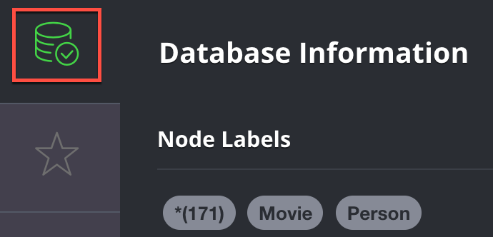
Labels
(:Person)
(p:Person)
(:Location)
(l:Location)
(n:Residence)
(x:Location:Residence)
MARRIED
Person
Person
LIVES_AT
LIVES_AT
OWNS
Location
Residence
Notes:
Point out the use of variables here.

Slide 67
Comments in Cypher
() // anonymous node not be referenced later in the query
(p) // variable p, a reference to a node used later
(:Person) // anonymous node of type Person
(p:Person) // p, a reference to a node of type Person
(p:Actor:Director) // p, a reference to a node of types Actor and Director

Slide 68
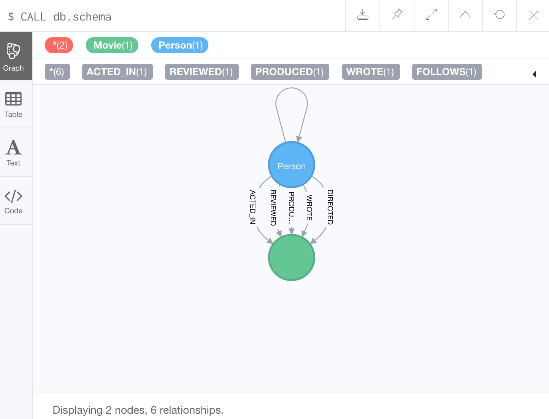
Examining the data model

Slide 69
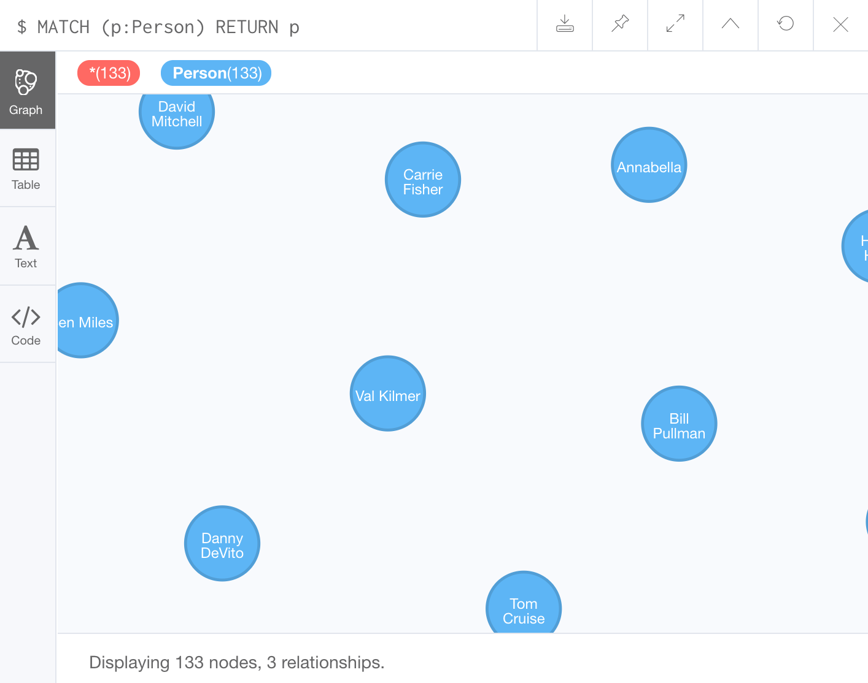
Using MATCH to retrieve nodes
MATCH (n) // returns all nodes in the graph
RETURN n
MATCH (p:Person) // returns all Person nodes in the graph
RETURN p
Notes:
Emphasize that node labels should ALWAYS be specified as this improves performance.

Slide 70
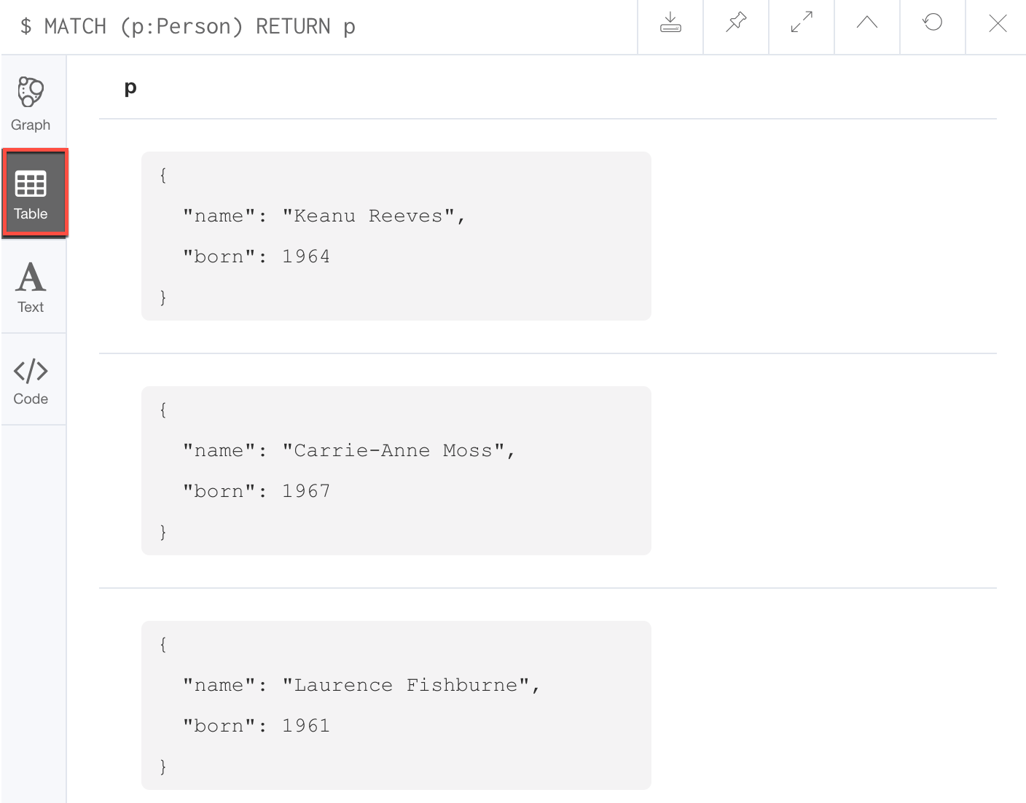
Viewing nodes as table data

Slide 71
Exercise 1:
Retrieving Nodes
In Neo4j Browser:
:play intro-exercises
Then follow instructions for Exercise 1.
Notes:
Show students how to :play intro-exercises
and how to navigate to Exercise 1.
They should have already populated the database from the Neo4j Guided Exercise in the previous lesson, but if they have not, there is a script at the beginning of each Exercise to delete all nodes and re-populate the database.
Note: If students are using a Sandbox, they could run into access issues if they have an ad blocker, or on a VPN, or if certain ports are blocked.

Slide 72
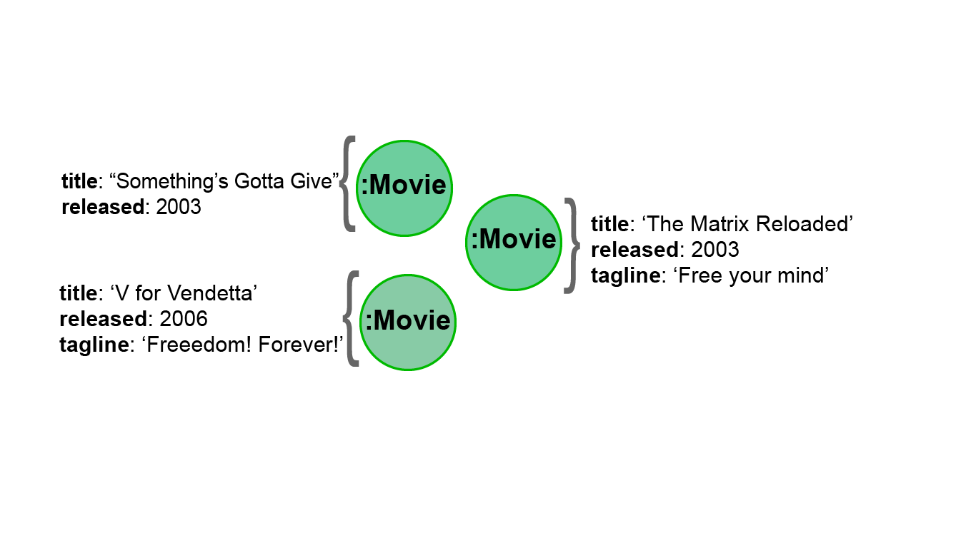
Properties

Slide 73
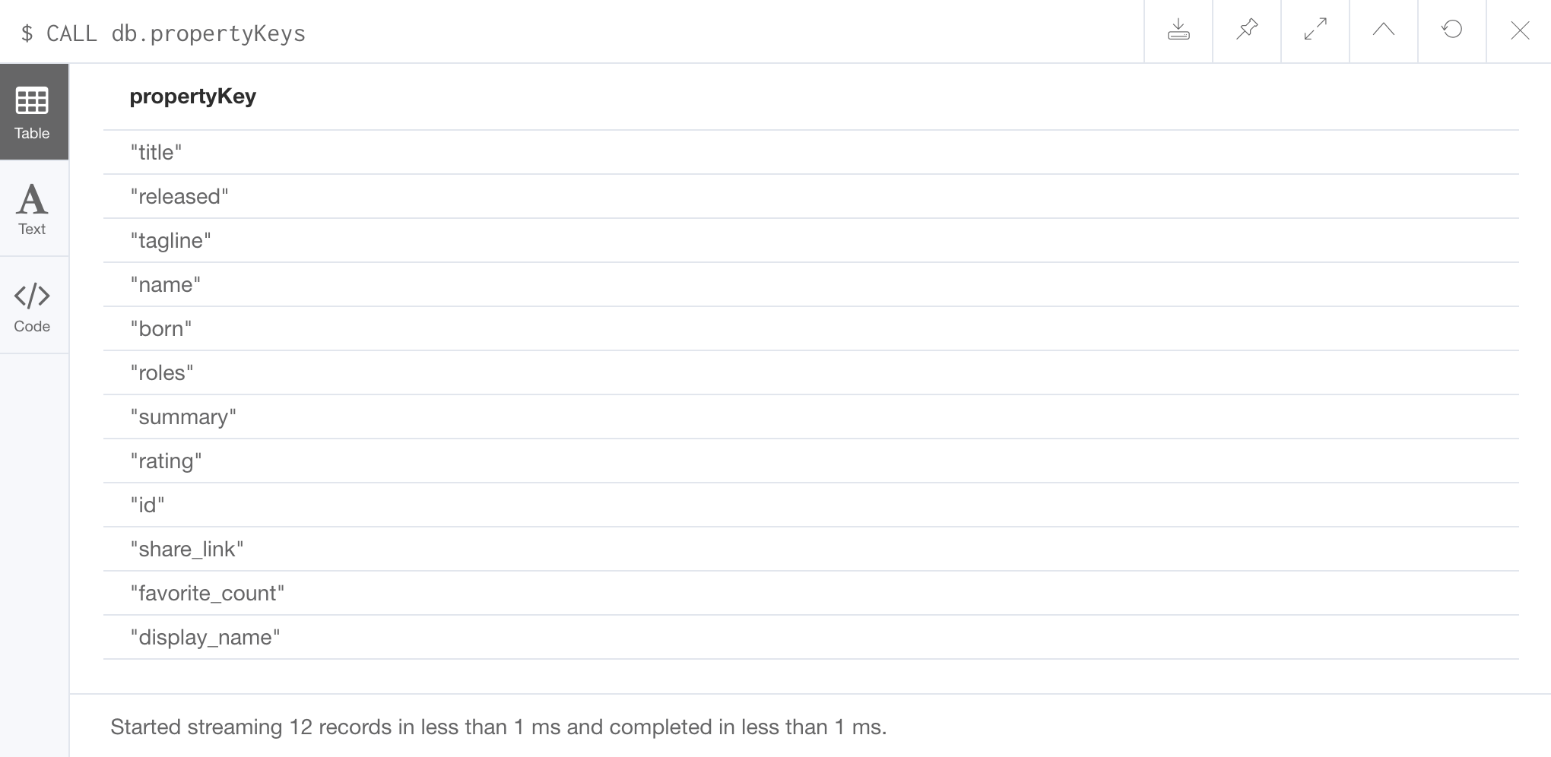
Examining property keys
CALL db.propertyKeys

Slide 74
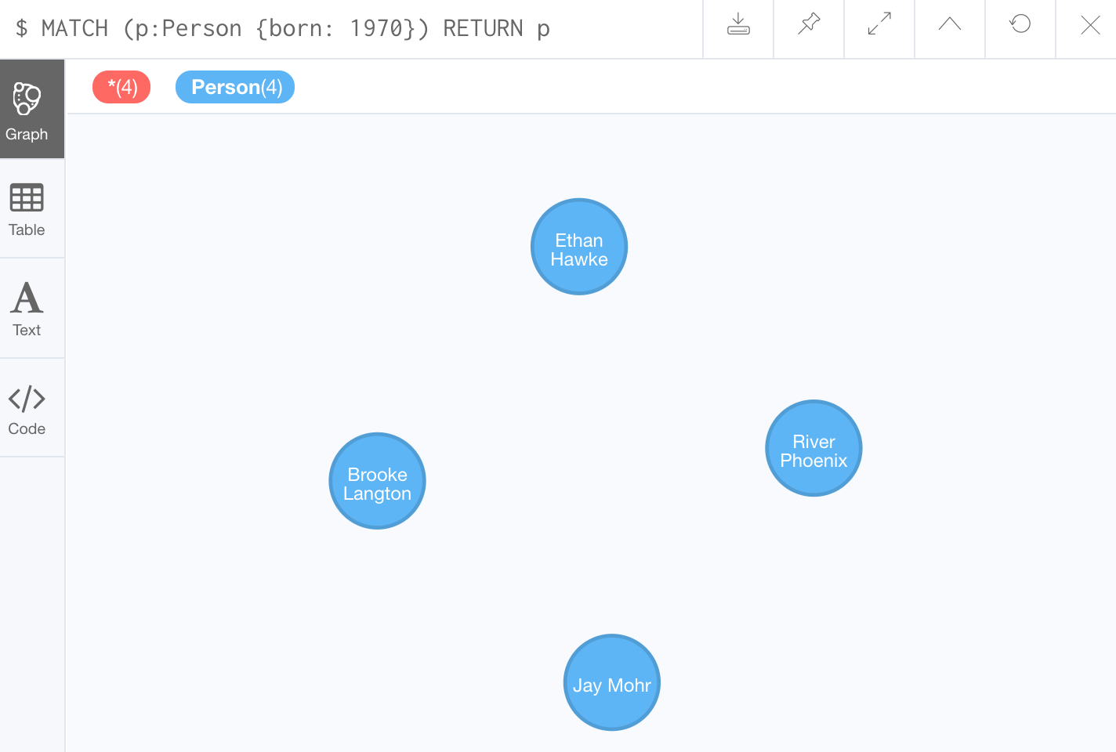
Retrieving nodes filtered by a property value - 1
Find all people born in 1970, returning the nodes:
MATCH (p:Person {born: 1970})
RETURN p

Slide 75
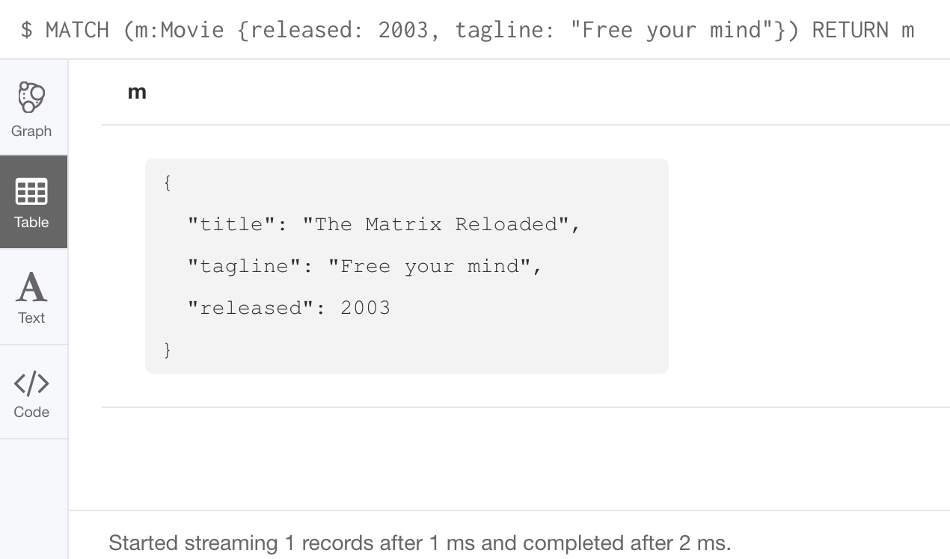
Retrieving nodes filtered by a property value - 2
Find all movies released in 2003 with the tagline,
Free your mind, returning the nodes:
MATCH (m:Movie {released: 2003, tagline: ‘Free your mind’})
RETURN m

Slide 76
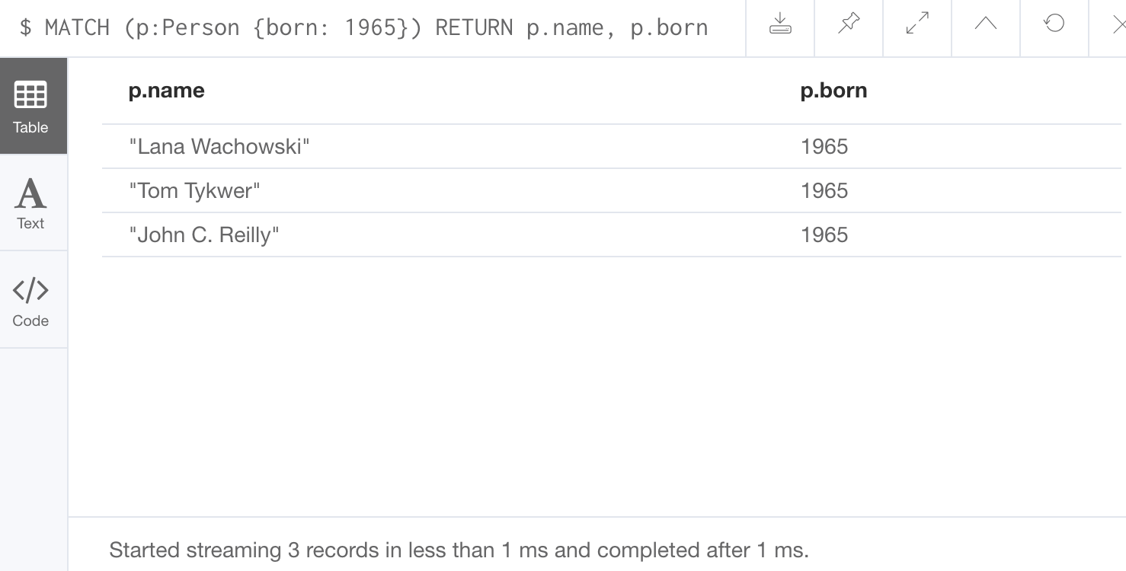
Returning property values
Find all people born in 1965 and return their names:
MATCH (p:Person {born: 1965})
RETURN p.name, p.born

Slide 77
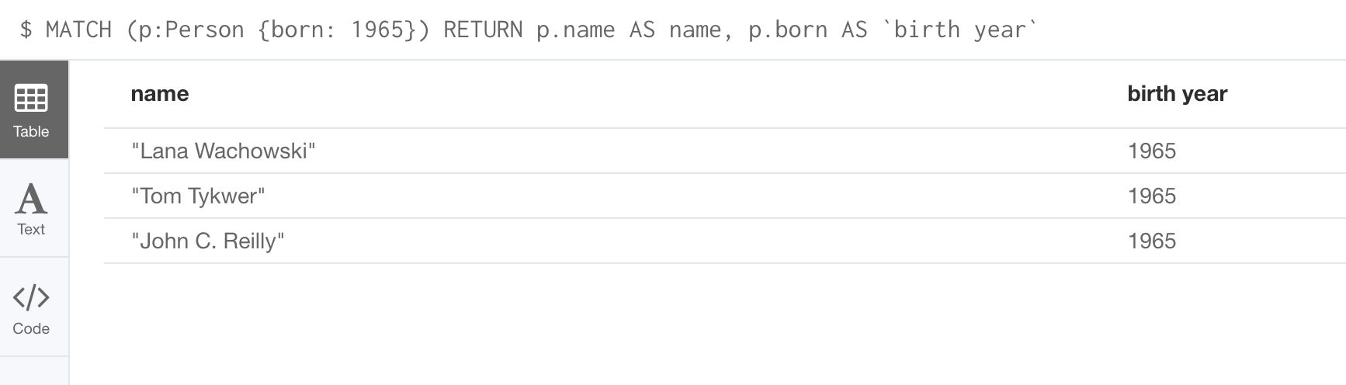
Specifying aliases
MATCH (p:Person {born: 1965})
RETURN p.name AS name, p.born AS `birth year`

Slide 78
Exercise 2:
Filtering queries using property values
In Neo4j Browser:
:play intro-exercises
Then follow instructions for Exercise 2.
Notes:
Show students how to :play intro-exercises
and how to navigate to Exercise 2.

Slide 79
Relationships
MARRIED
Person
Person
LIVES_AT
LIVES_AT
OWNS
Location
Residence

Slide 80
ASCII art for nodes and relationships
() // a node ()--() // 2 nodes have some type of relationship ()-->() // the first node has a relationship to the second node ()<--() // the second node has a relationship to the first node

Slide 81
Querying using relationships
MARRIED
Person
Person
LIVES_AT
LIVES_AT
OWNS
Location
Residence
MATCH (p:Person)-[:LIVES_AT]->(h:Residence)
RETURN p.name, h.address
MATCH (p:Person)--(h:Residence) // any relationship
RETURN p.name, h.address
Notes:
The second query produces duplicate data since there are three relationships here. We cover DISTINCT later in the course.

Slide 82
Examining relationships
CALL db.schema

Slide 83
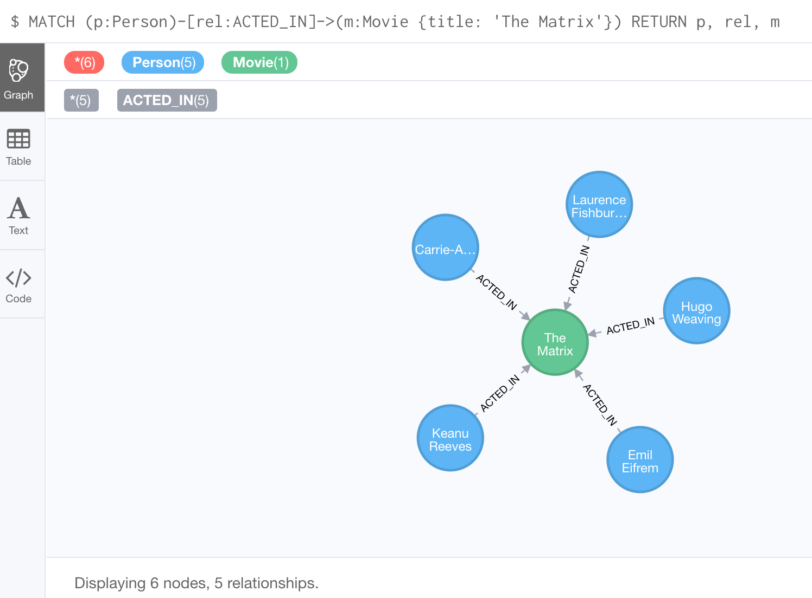
Using a relationship in a query
Find all people who acted in the movie, The Matrix, returning the nodes and relationships found:
MATCH (p:Person)-[rel:ACTED_IN]->(m:Movie {title: 'The Matrix'}) RETURN p, rel, m
Notes:
Emphasize the importance of specifying the node labels once again

Slide 84
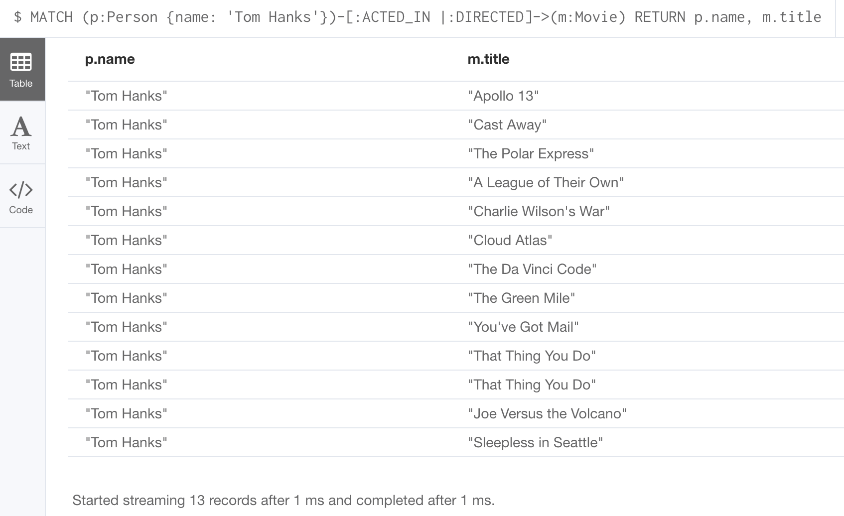
Querying by multiple relationships
Find all movies that Tom Hanks acted in or directed and return the title of the move:
MATCH (p:Person {name: 'Tom Hanks'})-[:ACTED_IN |:DIRECTED]->(m:Movie) RETURN p.name, m.title
Notes:
Note: Having to specify [:ACTED_IN | :DIRECTED] will soon be deprecated. In the future, you will specify the relationship as: [:ACTED_IN | DIRECTED]

Slide 85
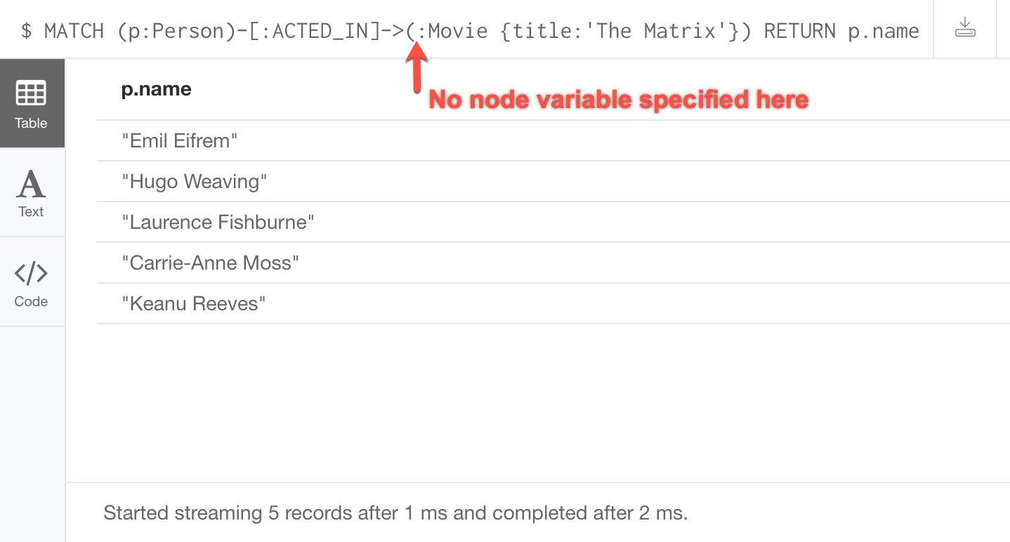
Using anonymous nodes in a query
Find all people who acted in the movie, The Matrix and return their names:
MATCH (p:Person)-[:ACTED_IN]->(:Movie {title: 'The Matrix'})
RETURN p.name
Notes:
Best practice is to place named nodes before anonymous nodes in the query.

Slide 86
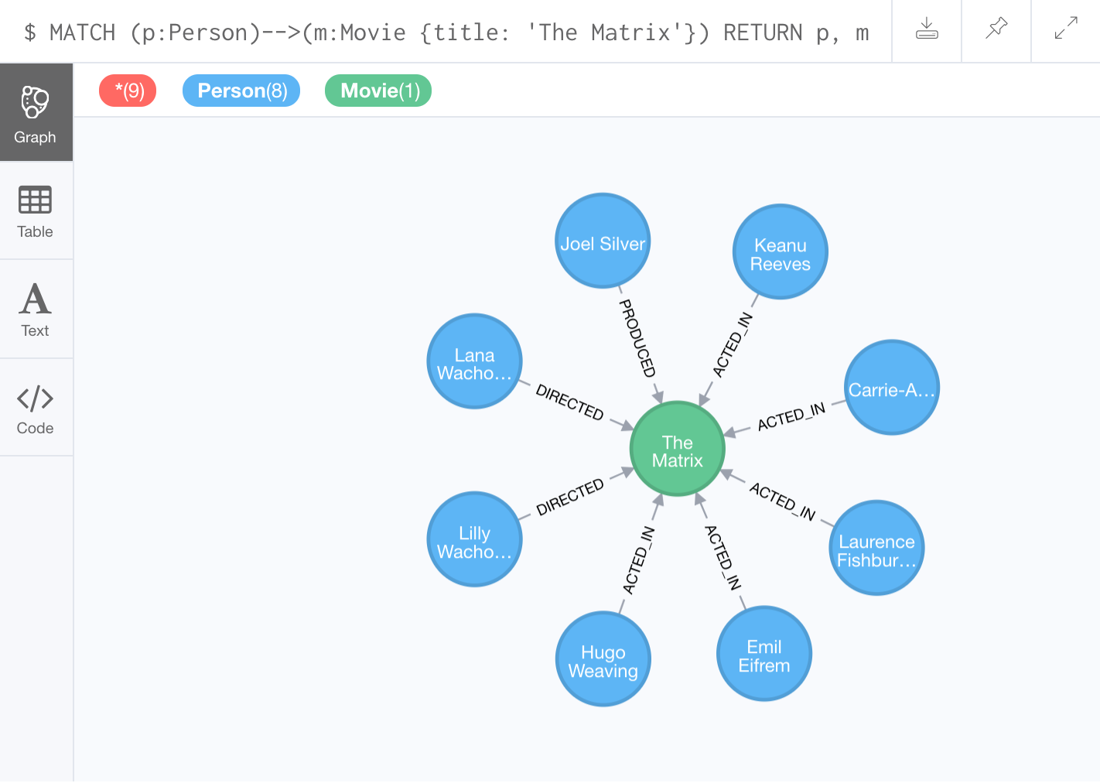
Using an anonymous relationship for a query
Find all people who have any type of relationship to the movie, The Matrix and return the nodes:
MATCH (p:Person)-->(m:Movie {title: 'The Matrix'})
RETURN p, m
Connect result nodes enabled in Neo4j Browser
Notes:
In this training, we will use `-->`, `--`, and `<--` to represent anonymous relationships as it is a Cypher best practice.

Slide 87
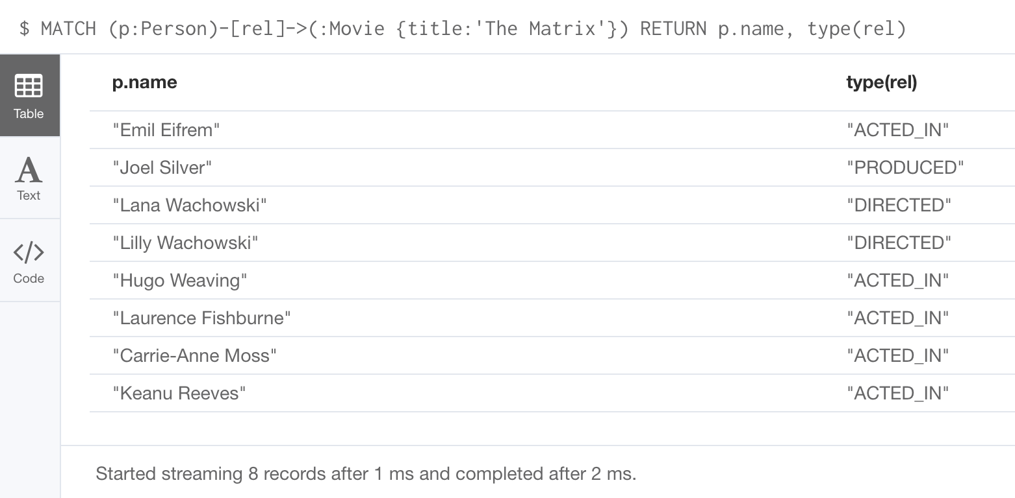
Retrieving relationship types
Find all people who have any type of relationship to the movie, The Matrix and return the name of the person and their relationship type:
MATCH (p:Person)-[rel]->(:Movie {title:'The Matrix'})
RETURN p.name, type(rel)

Slide 88
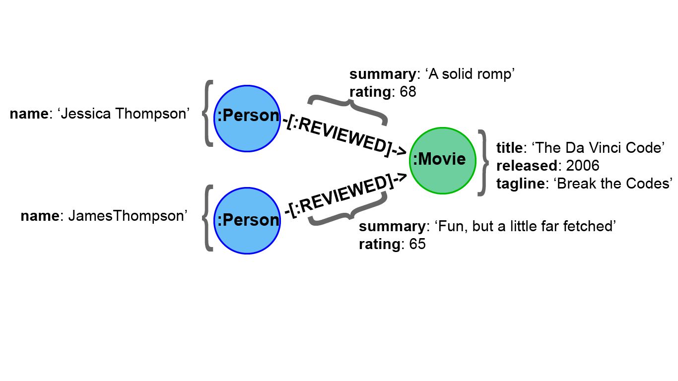
Retrieving properties for a relationship - 1

Slide 89
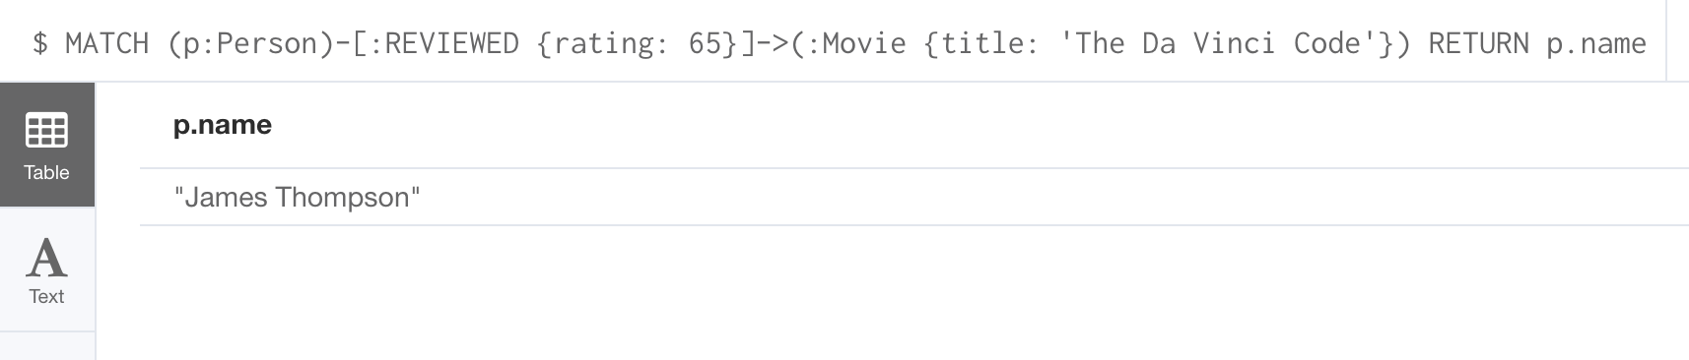
Retrieving properties for a relationship - 2
Find all people who gave the movie, The Da Vinci Code, a rating of 65, returning their names:
MATCH (p:Person)-[:REVIEWED {rating: 65}]->(:Movie {title: 'The Da Vinci Code'}) RETURN p.name

Slide 90
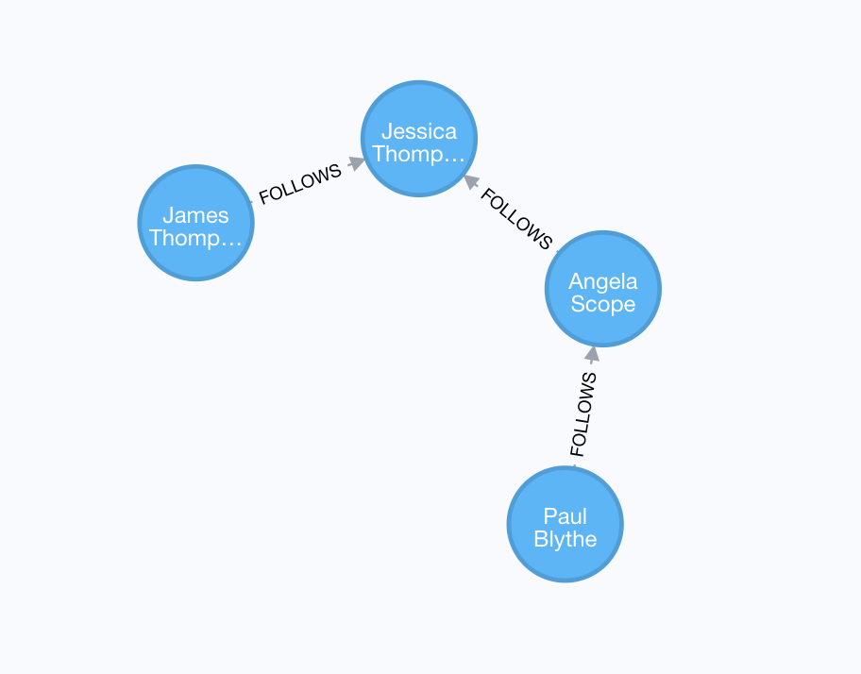
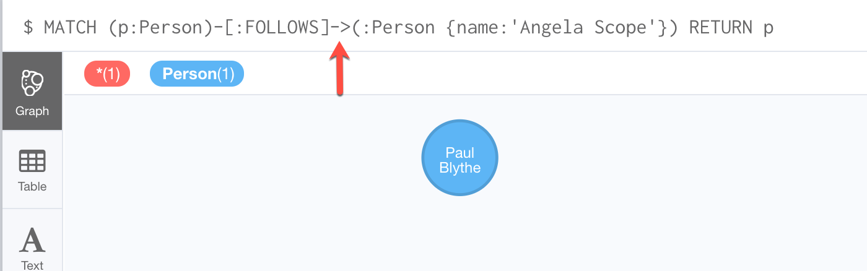
Using patterns for queries - 1
Find all people who follow Angela Scope,
returning the nodes:
MATCH (p:Person)-[:FOLLOWS]->(:Person {name:'Angela Scope'})
RETURN p

Slide 91
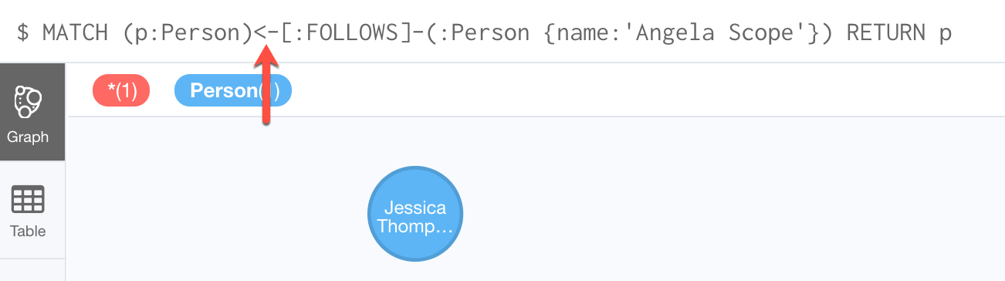
Using patterns for queries - 2
Find all people who Angela Scope follows,
returning the nodes:
MATCH (p:Person)<-[:FOLLOWS]-(:Person {name:'Angela Scope'})
RETURN p

Slide 92
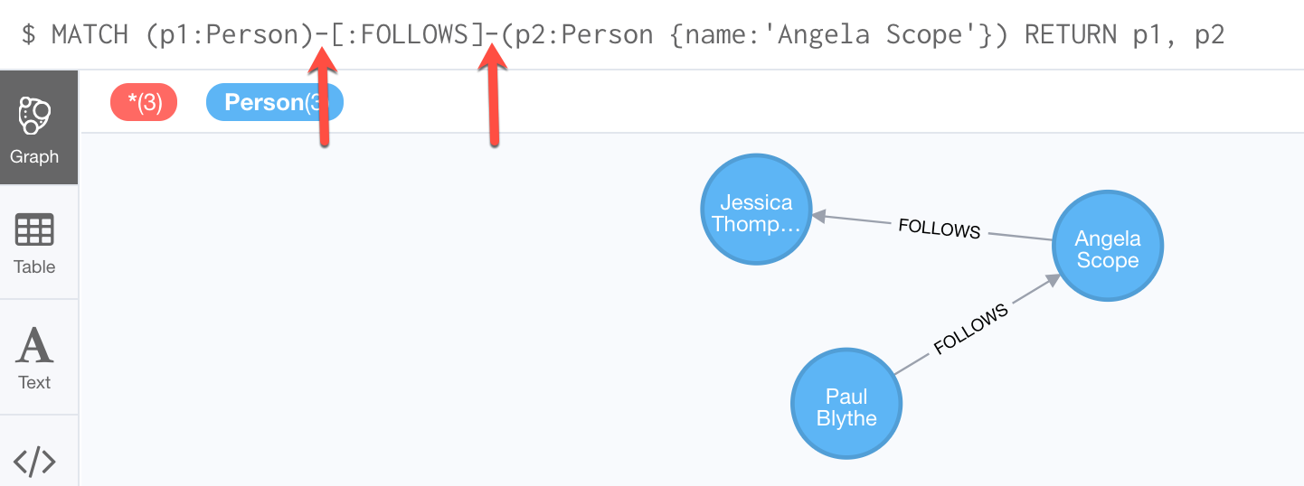
Querying by any direction of the relationship
Find all people who follow Angela Scope or
who Angela Scope follows, returning the nodes:
MATCH (p1:Person)-[:FOLLOWS]-(p2:Person {name:'Angela Scope'})
RETURN p1, p2

Slide 93
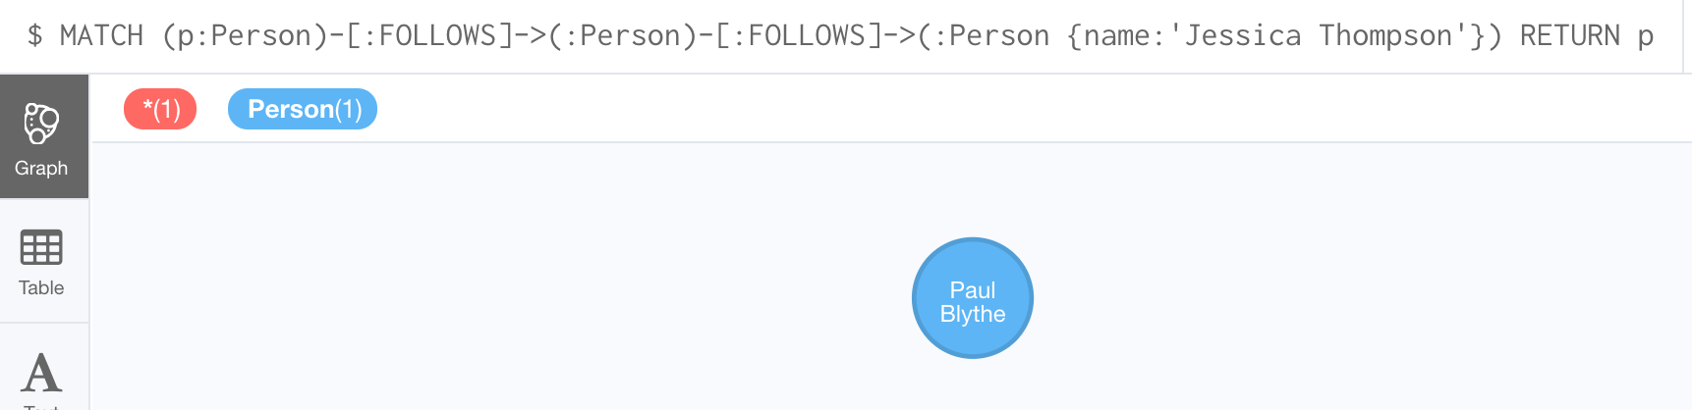
Traversing relationships - 1
Find all people who follow anybody who follows
Jessica Thompson returning the people as nodes:
MATCH (p:Person)-[:FOLLOWS]->(:Person)-[:FOLLOWS]->
(:Person {name:'Jessica Thompson'})
RETURN p

Slide 94
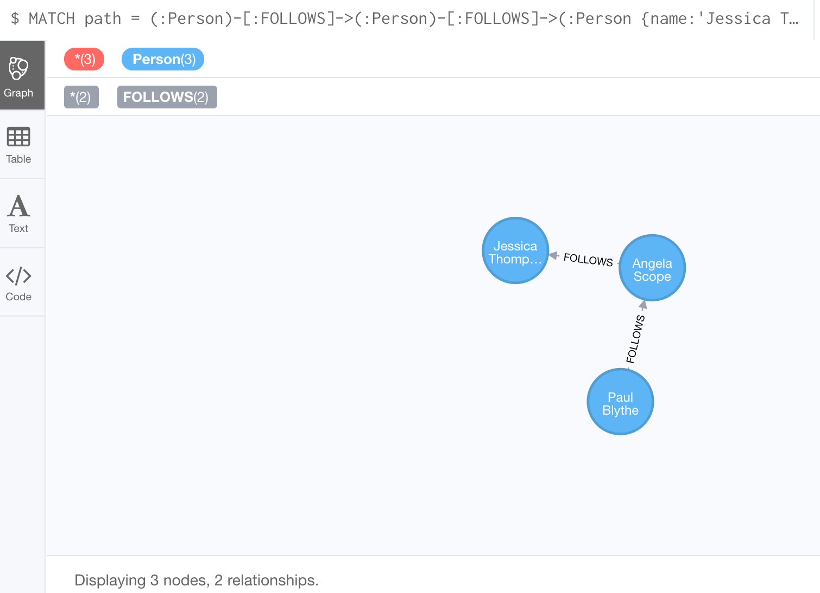
Traversing relationships - 2
Find the path that includes all people who follow
anybody who follows Jessica Thompson returning the
path:
MATCH path = (:Person)-[:FOLLOWS]->(:Person)-[:FOLLOWS]->
(:Person {name:'Jessica Thompson'})
RETURN path
Sub-graph

Slide 95
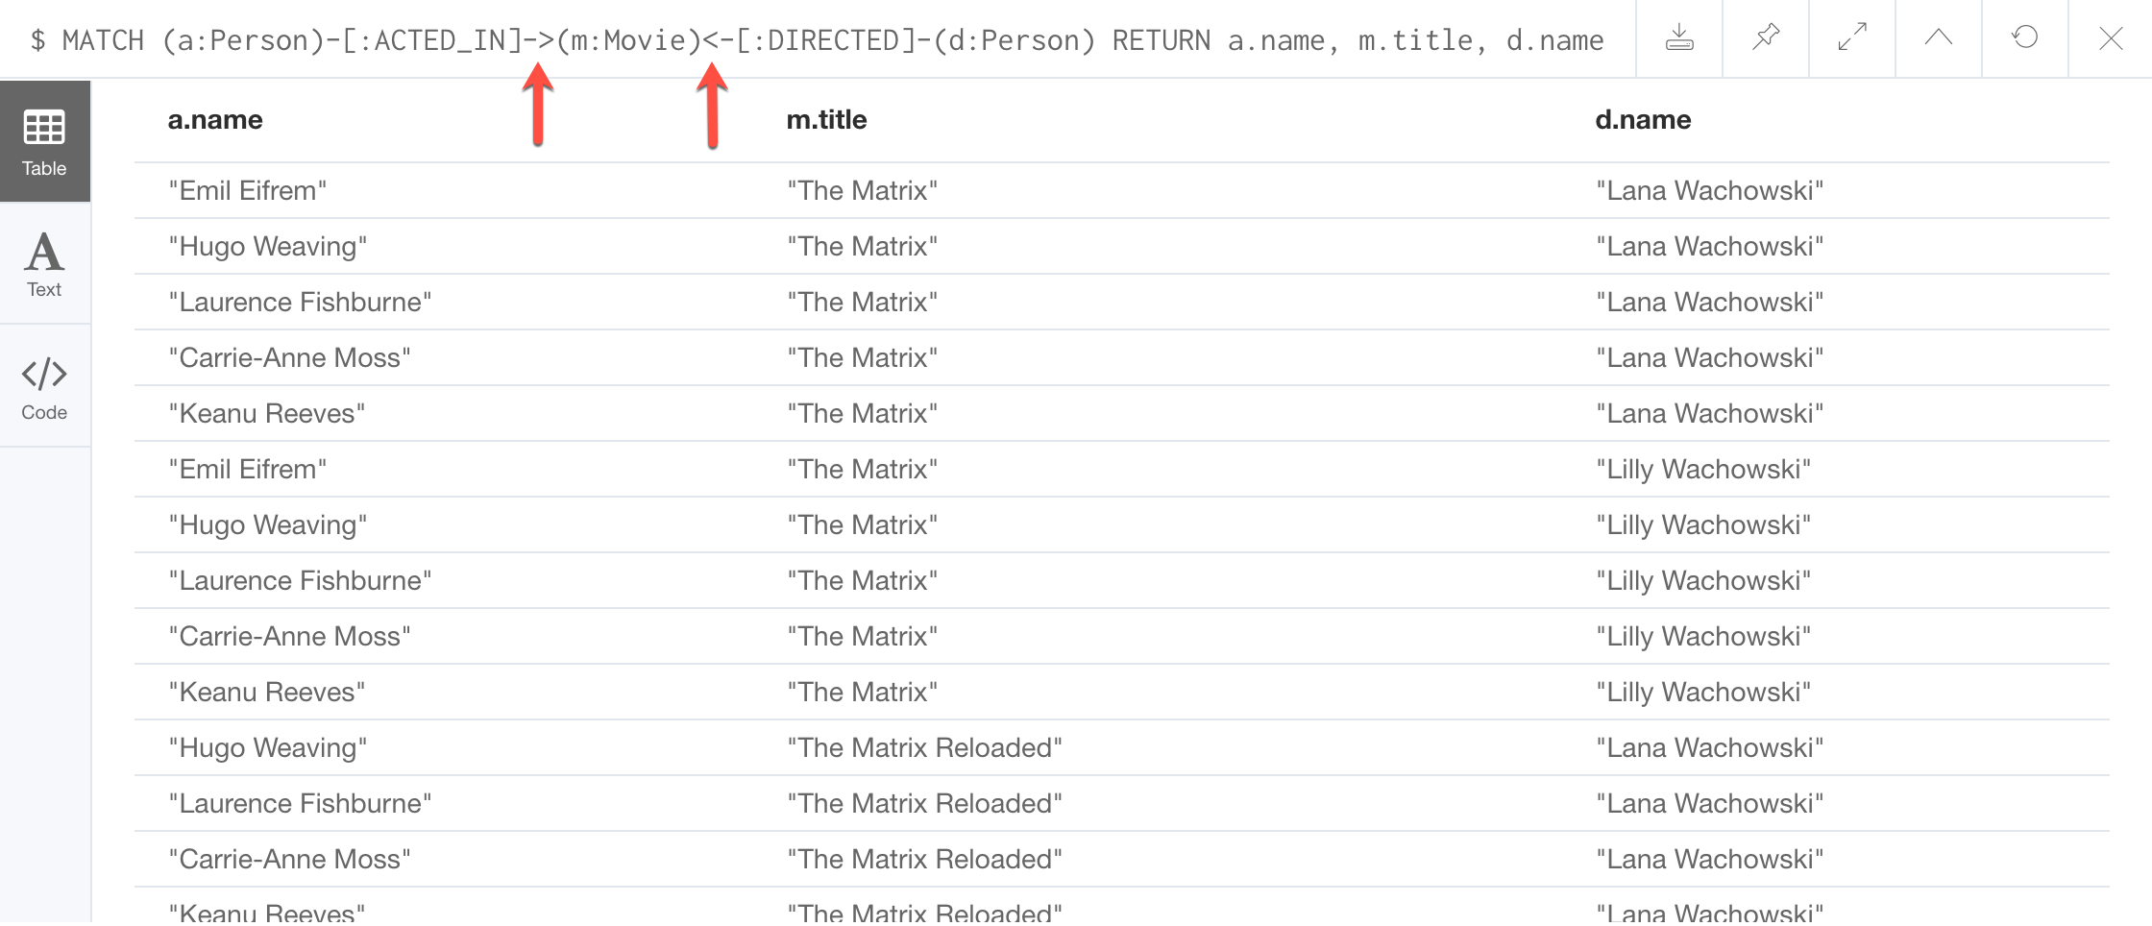
Using relationship direction to optimize a query
Find all people that acted in a movie and the directors for that same movie, returning the name of the actor, the movie title, and the name of the director:
MATCH (a:Person)-[:ACTED_IN]->(m:Movie)<-[:DIRECTED]-(d:Person) RETURN a.name, m.title, d.name
Notes:
Point out that there are duplicate rows returned - will learn about DISTINCT later.

Slide 96
Cypher style recommendations - 1
Here are the Neo4j-recommended Cypher coding standards that we use in this training:
Node labels are CamelCase and case-sensitive (examples: Person, NetworkAddress).
Property keys, variables, parameters, aliases, and functions are camelCase case-sensitive (examples: businessAddress, title).
Relationship types are in upper-case and can use the underscore. (examples: ACTED_IN, FOLLOWS).
Cypher keywords are upper-case (examples: MATCH, RETURN).

Slide 97
Cypher style recommendations - 2
Here are the Neo4j-recommended Cypher coding standards that we use in this training:
String constants are in single quotes (with exceptions).
Specify variables only when needed for use later in the Cypher statement.
Place named nodes and relationships (that use variables) before anonymous nodes and relationships in your MATCH clauses when possible.
Specify anonymous relationships with -->, --, or <--
MATCH (:Person {name: 'Diane Keaton'})-[movRel:ACTED_IN]-> (:Movie {title:"Something's Gotta Give"}) RETURN movRel.roles
Notes:
Show them the Cypher Style Guide: https://github.com/opencypher/openCypher/blob/master/docs/style-guide.adoc

Slide 98
Exercise 3:
Filtering queries using relationships
In Neo4j Browser:
:play intro-exercises
Then follow instructions for Exercise 3.
Notes:
Show students how to :play intro-exercises
and how to navigate to Exercise 3.

Slide 99
Check your understanding

Slide 100
Question 1
Suppose you have a graph that contains nodes representing customers and other business entities for your application. The node label in the database for a customer is Customer. Each Customer node has a property named email that contains the customer’s email address. What Cypher query do you execute to return the email addresses for all customers in the graph?
Select the correct answer.
❏ MATCH (n) RETURN n.Customer.email
❏ MATCH (c:Customer) RETURN c.email
❏ MATCH (Customer) RETURN email
❏ MATCH (c) RETURN Customer.email
Notes:
Suppose you have a graph that contains nodes representing customers and other business entities for your application. The node label in the database for a customer is Customer. Each Customer node has a property named email that contains the customer’s email address. What Cypher query do you execute to return the email addresses for all customers in the graph?
Select the correct answer.
❏ MATCH (n) RETURN n.Customer.email
✅ MATCH (c:Customer) RETURN c.email
❏ MATCH (Customer) RETURN email
❏ MATCH (c) RETURN Customer.email

Slide 101
Answer 1
Suppose you have a graph that contains nodes representing customers and other business entities for your application. The node label in the database for a customer is Customer. Each Customer node has a property named email that contains the customer’s email address. What Cypher query do you execute to return the email addresses for all customers in the graph?
Select the correct answer.
❏ MATCH (n) RETURN n.Customer.email
✅ MATCH (c:Customer) RETURN c.email
❏ MATCH (Customer) RETURN email
❏ MATCH (c) RETURN Customer.email

Slide 102
Question 2
Suppose you have a graph that contains Customer and Product nodes. A Customer node can have a BOUGHT relationship with a Product node. Customer nodes can have other relationships with Product nodes. A Customer node has a property named customerName. A Product node has a property named productName. What Cypher query do you execute to return all of the products (by name) bought by customer 'ABCCO'.
Select the correct answer.
❏ MATCH (c:Customer {customerName: 'ABCCO'}) RETURN c.BOUGHT.productName
❏ MATCH (:Customer 'ABCCO')-[:BOUGHT]→(p:Product) RETURN p.productName
❏ MATCH (p:Product)←[:BOUGHT_BY]-(:Customer 'ABCCO') RETURN p.productName
❏ MATCH (:Customer {customerName: 'ABCCO'})-[:BOUGHT]→(p:Product) RETURN p.productName
Notes:
Suppose you have a graph that contains Customer and Product nodes. A Customer node can have a BOUGHT relationship with a Product node. Customer nodes can have other relationships with Product nodes. A Customer node has a property named customerName. A Product node has a property named productName. What Cypher query do you execute to return all of the products (by name) bought by customer 'ABCCO'.
Select the correct answer.
❏ MATCH (c:Customer {customerName: 'ABCCO'}) RETURN c.BOUGHT.productName
❏ MATCH (:Customer 'ABCCO')-[:BOUGHT]→(p:Product) RETURN p.productName
❏ MATCH (p:Product)←[:BOUGHT_BY]-(:Customer 'ABCCO') RETURN p.productName
✅ MATCH (:Customer {customerName: 'ABCCO'})-[:BOUGHT]→(p:Product) RETURN p.productName

Slide 103
Answer 2
Suppose you have a graph that contains Customer and Product nodes. A Customer node can have a BOUGHT relationship with a Product node. Customer nodes can have other relationships with Product nodes. A Customer node has a property named customerName. A Product node has a property named productName. What Cypher query do you execute to return all of the products (by name) bought by customer 'ABCCO'.
Select the correct answer.
❏ MATCH (c:Customer {customerName: 'ABCCO'}) RETURN c.BOUGHT.productName
❏ MATCH (:Customer 'ABCCO')-[:BOUGHT]→(p:Product) RETURN p.productName
❏ MATCH (p:Product)←[:BOUGHT_BY]-(:Customer 'ABCCO') RETURN p.productName
✅ MATCH (:Customer {customerName: 'ABCCO'})-[:BOUGHT]→(p:Product) RETURN p.productName

Slide 104
Question 3
When must you use a variable in a MATCH clause?
Select the correct answer.
❏ When you want to query the graph using a node label.
❏ When you specify a property value to match the query.
❏ When you want to use the node or relationship to return a result.
❏ When the query involves two types of nodes.
Notes:
When must you use a variable in a MATCH clause?
Select the correct answer.
❏ When you want to query the graph using a node label.
❏ When you specify a property value to match the query.
✅ When you want to use the node or relationship to return a result.
❏ When the query involves two types of nodes.

Slide 105
Answer 3
When must you use a variable in a MATCH clause?
Select the correct answer.
❏ When you want to query the graph using a node label.
❏ When you specify a property value to match the query.
✅ When you want to use the node or relationship to return a result.
❏ When the query involves two types of nodes.

Slide 106
Summary
You should be able to write Cypher statements to:
Retrieve nodes from the graph.
Filter nodes retrieved using labels and property values of nodes.
Retrieve property values from nodes in the graph.
Filter nodes retrieved using relationships.

Slide 107
Getting More Out of Queries

Slide 108
Overview
At the end of this module, you should be able to write Cypher statements to:
Filter queries using the WHERE clause
Control query processing
Control what results are returned
Work with Cypher lists and dates

Slide 109
Filtering queries using WHERE
Previously you retrieved nodes as follows:
MATCH (p:Person)-[:ACTED_IN]->(m:Movie {released: 2008})
RETURN p, m
A more flexible syntax for the same query is:
MATCH (p:Person)-[:ACTED_IN]->(m:Movie)
WHERE m.released = 2008
RETURN p, m
Testing more than equality:
MATCH (p:Person)-[:ACTED_IN]->(m:Movie)
WHERE m.released = 2008 OR m.released = 2009
RETURN p, m
Notes:
With the WHERE clause, you can specify complex conditions whereas in the original query, the only condition you can test is equality

Slide 110
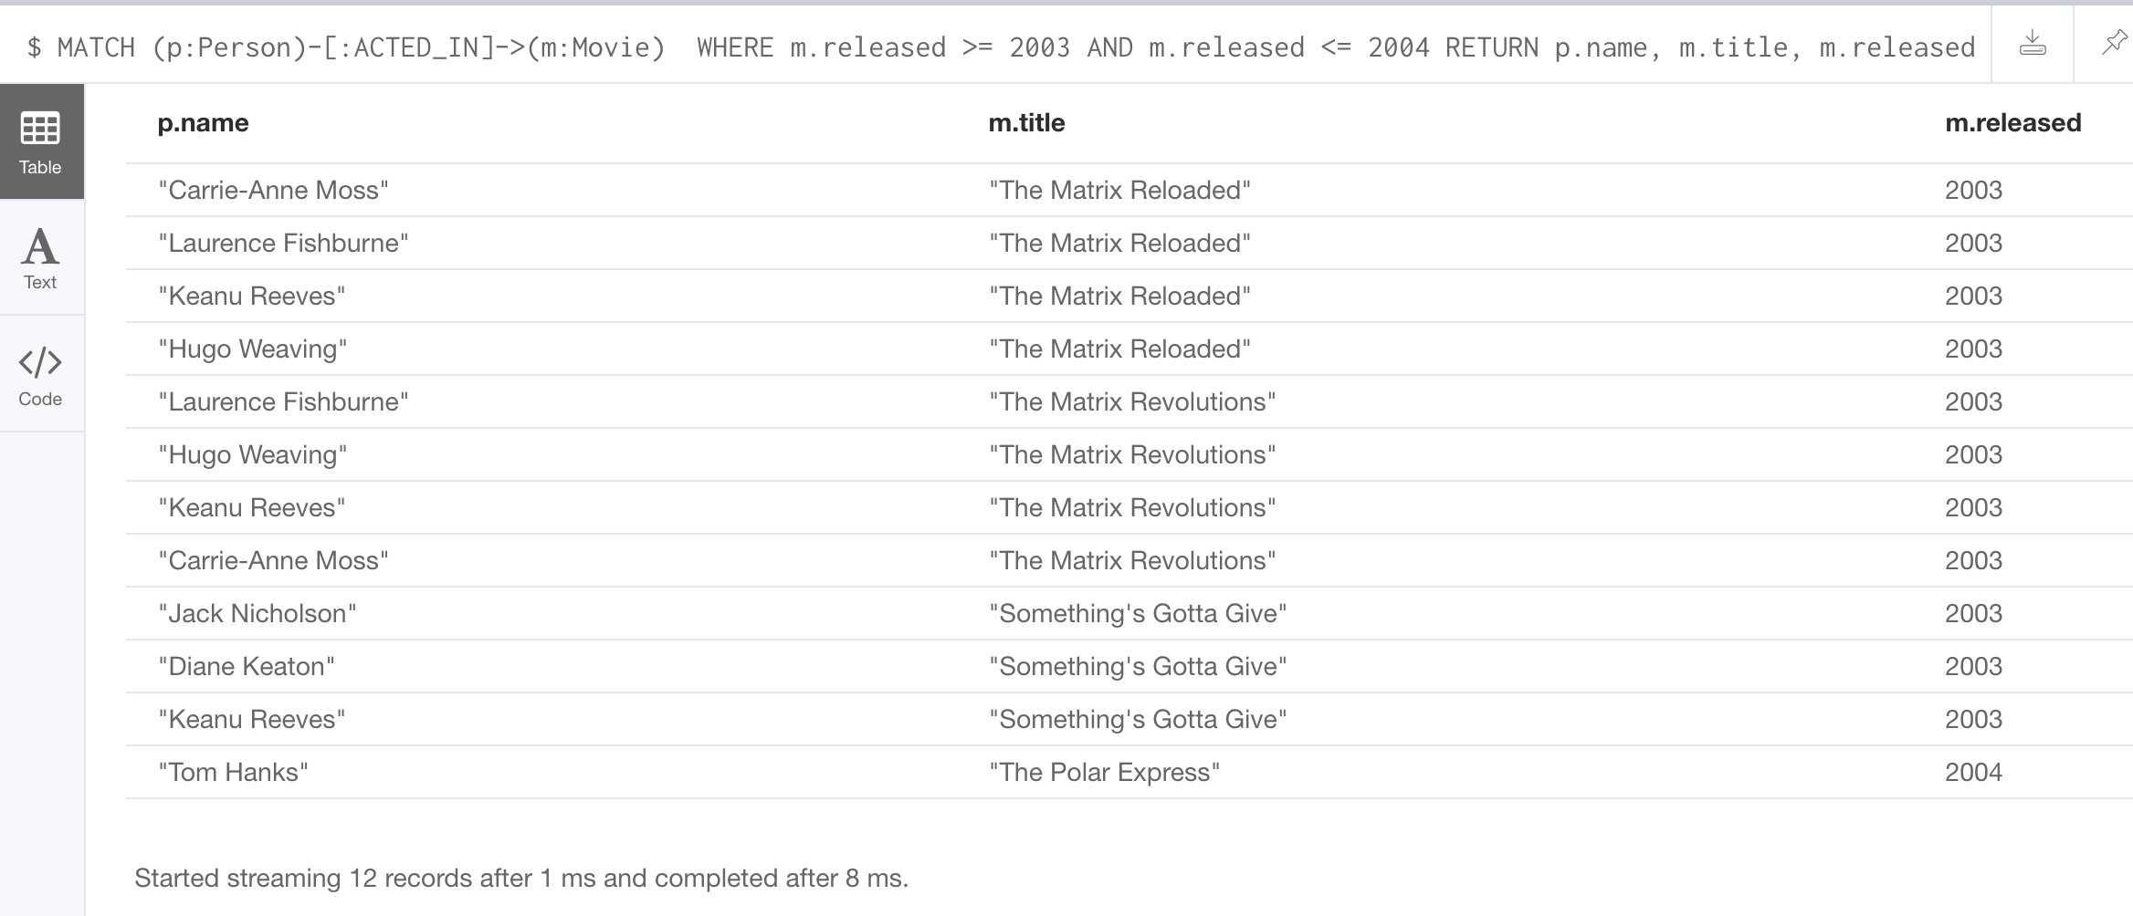
Specifying ranges in WHERE clauses
This query to find all people who acted in movies released between 2003 and 2004:
MATCH (p:Person)-[:ACTED_IN]->(m:Movie)
WHERE m.released >= 2003 AND m.released <= 2004
RETURN p.name, m.title, m.released
Is the same as:
MATCH (p:Person)-[:ACTED_IN]->(m:Movie)
WHERE 2003 <= m.released <= 2004
RETURN p.name, m.title, m.released
Notes:
You can use the boolean operators including OR, AND, NOT, XOR to specify a logical condition that is tested at runtime.

Slide 111
Testing labels
These queries:
MATCH (p:Person)
RETURN p.name
MATCH (p:Person)-[:ACTED_IN]->(:Movie {title: 'The Matrix'})
RETURN p.name
Can be rewritten as:
MATCH (p) WHERE p:Person RETURN p.name
MATCH (p)-[:ACTED_IN]->(m) WHERE p:Person AND m:Movie AND m.title='The Matrix' RETURN p.name

Slide 112
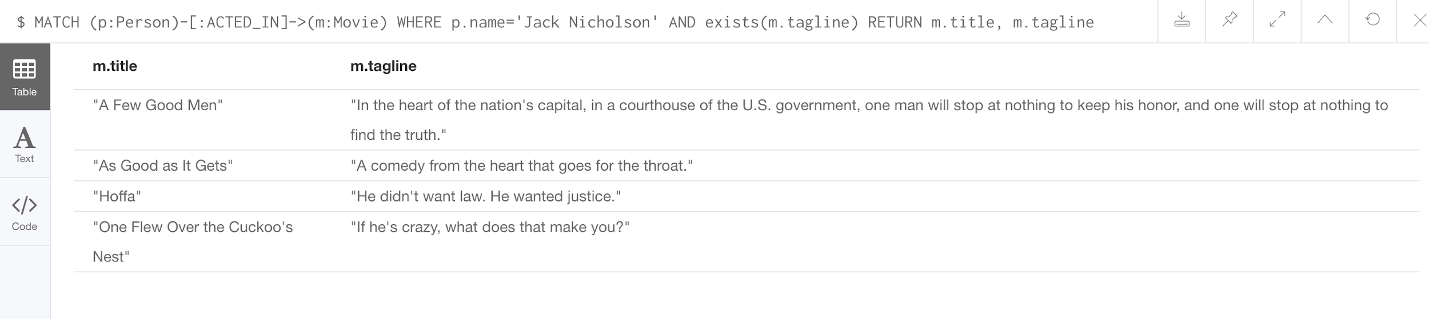
Testing the existence of a property
Find all movies that Jack Nicholson acted in that have a tagline, returning the title and tagline of the movie:
MATCH (p:Person)-[:ACTED_IN]->(m:Movie) WHERE p.name='Jack Nicholson' AND exists(m.tagline) RETURN m.title, m.tagline

Slide 113
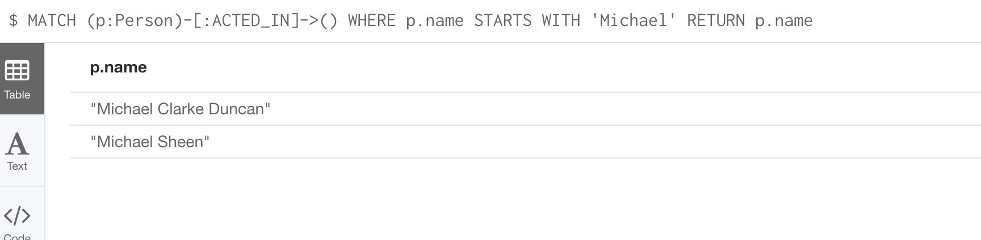
Testing strings
Find all actors whose name begins with Michael:
MATCH (p:Person)-[:ACTED_IN]->() WHERE p.name STARTS WITH 'Michael' RETURN p.name
MATCH (p:Person)-[:ACTED_IN]->() WHERE toLower(p.name) STARTS WITH 'michael' RETURN p.name
Notes:
There are many other string related built-in functions you can use in Cypher. See the Developer Reference documentation.

Slide 114
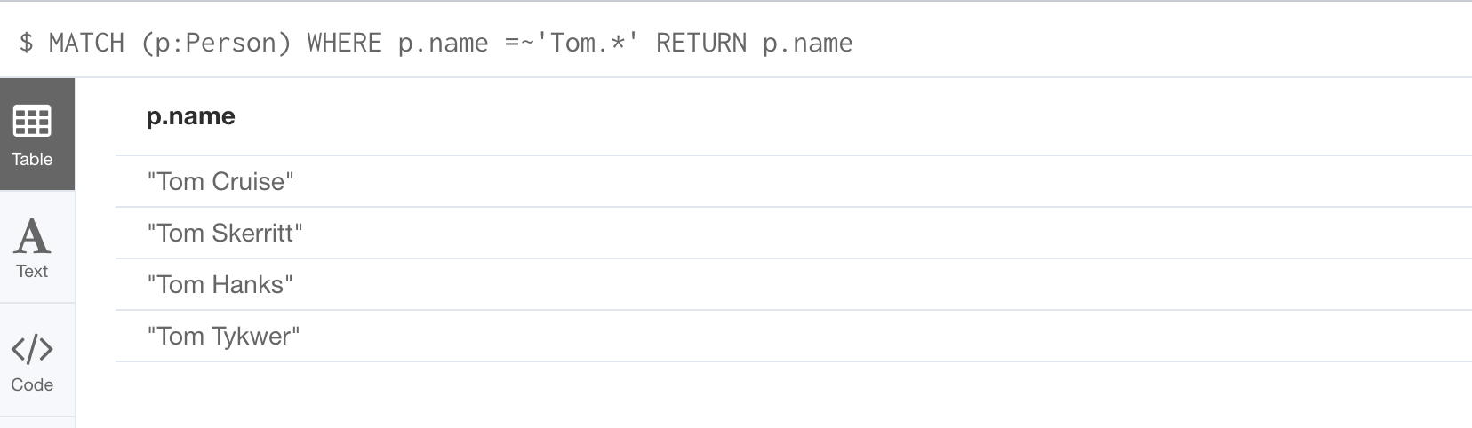
Testing with regular expressions
Find people whose name starts with Tom:
MATCH (p:Person) WHERE p.name =~'Tom.*' RETURN p.name
Notes:
Note: An index will never be used with a regular expression

Slide 115
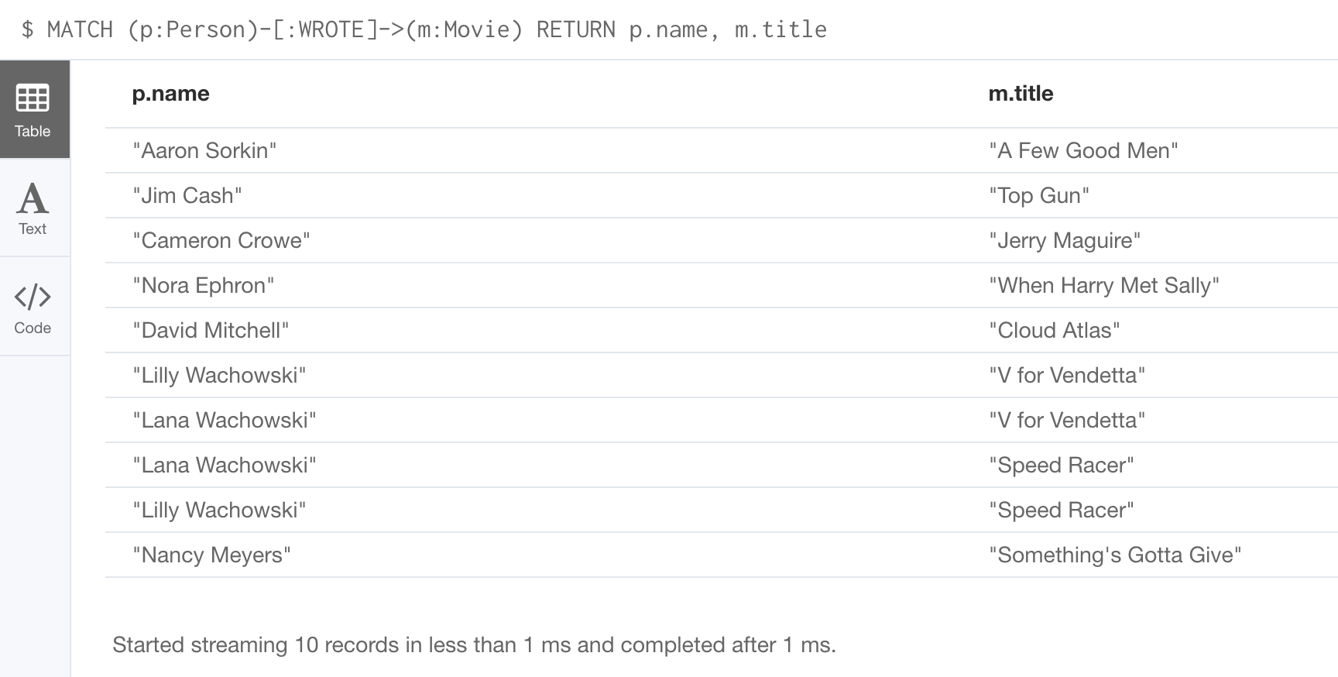
Testing with patterns - 1
Find all people who wrote movies returning their names and the title of the movie they wrote:
MATCH (p:Person)-[:WROTE]->(m:Movie) RETURN p.name, m.title

Slide 116
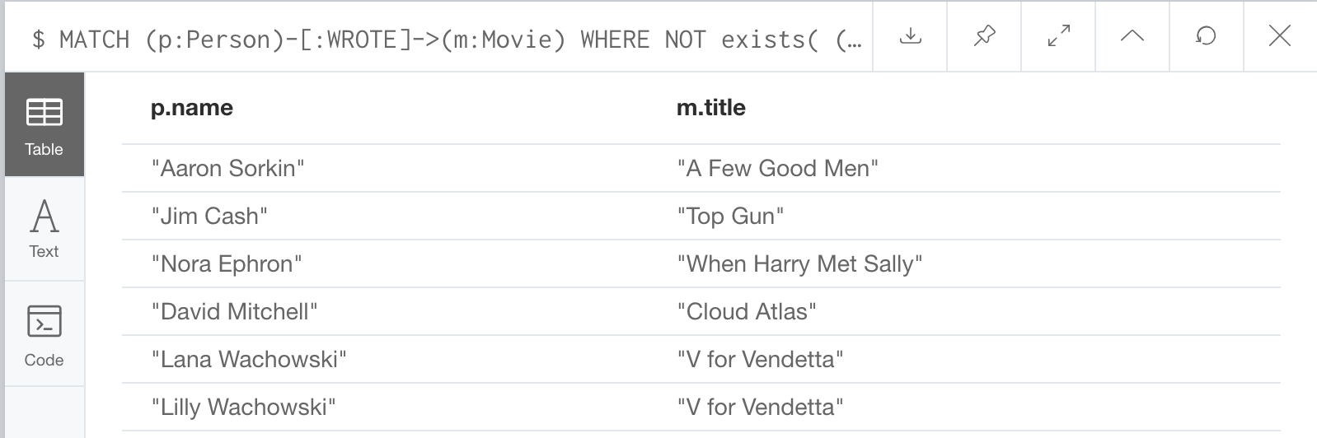
Testing with patterns - 2
Find the people who wrote movies, but did not direct them, returning their names and the title of the movie:
MATCH (p:Person)-[:WROTE]->(m:Movie) WHERE NOT exists( (p)-[:DIRECTED]->(m) ) RETURN p.name, m.title

Slide 117
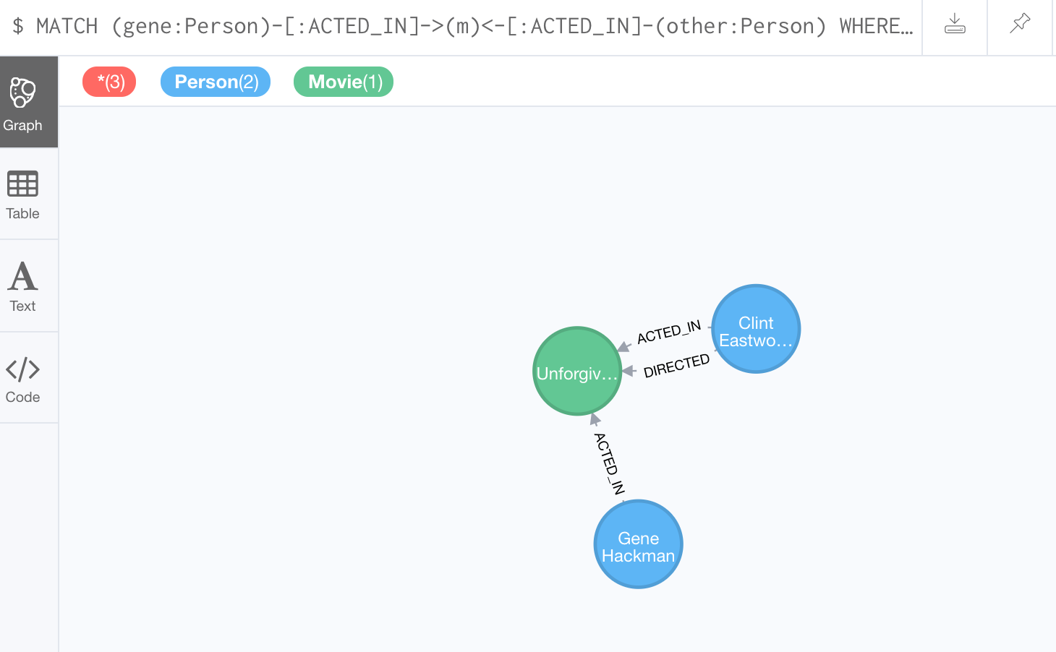
Testing with patterns - 3
Find Gene Hackman and the movies that he acted in with another person who also directed the movie, returning the nodes found:
MATCH (gene:Person)-[:ACTED_IN]->(m:Movie)<-[:ACTED_IN]-(other:Person) WHERE gene.name= ‘Gene Hackman’ AND exists( (other)-[:DIRECTED]->(m) ) RETURN gene, other, m

Slide 118
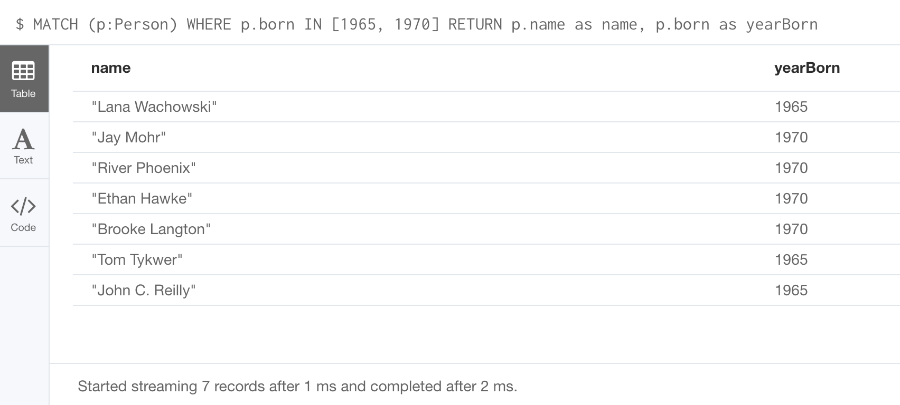
Testing with list values - 1
Find all people born in 1965 and 1970:
MATCH (p:Person) WHERE p.born IN [1965, 1970] RETURN p.name as name, p.born as yearBorn

Slide 119
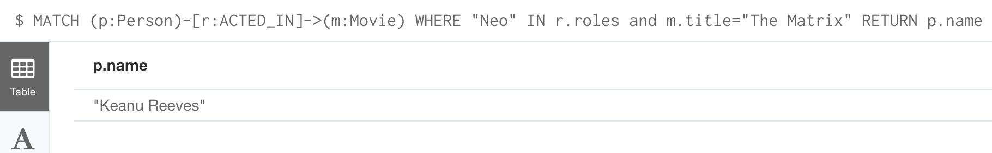
Testing with list values - 2
Find the actor who played Neo in the movie, The Matrix:
MATCH (p:Person)-[r:ACTED_IN]->(m:Movie) WHERE 'Neo' IN r.roles AND m.title='The Matrix' RETURN p.name

Slide 120
Exercise 4:
Filtering queries using the WHERE clause
In Neo4j Browser:
:play intro-exercises
Then follow instructions for Exercise 4.
Notes:
Show students how to :play intro-exercises
and how to navigate to Exercise 4.

Slide 121
Controlling query processing
Multiple MATCH clauses
Varying length paths
Collecting results into lists
Counting results

Slide 122
Specifying multiple MATCH patterns
This query to find people who either acted or directed a movie released in 2000 is specified with two MATCH patterns:
MATCH (a:Person)-[:ACTED_IN]->(m:Movie), (m:Movie)<-[:DIRECTED]-(d:Person) WHERE m.released = 2000 RETURN a.name, m.title, d.name
A best practice is to use a single MATCH pattern if possible:
MATCH (a:Person)-[:ACTED_IN]->(m:Movie)<-[:DIRECTED]-(d:Person) WHERE m.released = 2000 RETURN a.name, m.title, d.name
Notes:
There are, however, some queries where you will need to specify two or more patterns. Multiple patterns are used when a query is complex and cannot be satisfied with a single pattern. This is useful when you are looking for a specific node in the graph and want to connect it to a different node. You will learn about creating nodes and relationships later in this training.

Slide 123
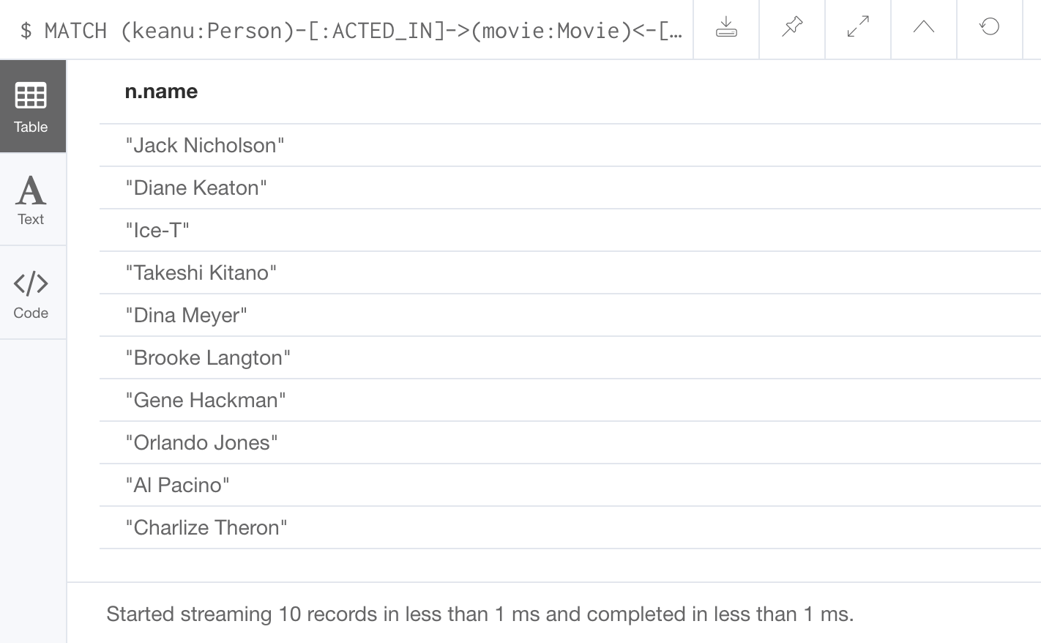
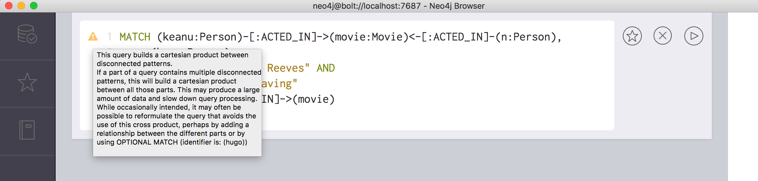
Example 1: Using two MATCH patterns
Find the actors who acted in the same movies as Keanu Reeves, but not when Hugo Weaving acted in the same movie:
MATCH (keanu:Person)-[:ACTED_IN]->(movie:Movie)<-[:ACTED_IN]-(n:Person), (hugo:Person) WHERE keanu.name=’Keanu Reeves’ AND hugo.name=’Hugo Weaving’ AND NOT (hugo)-[:ACTED_IN]->(movie) RETURN n.name

Slide 124
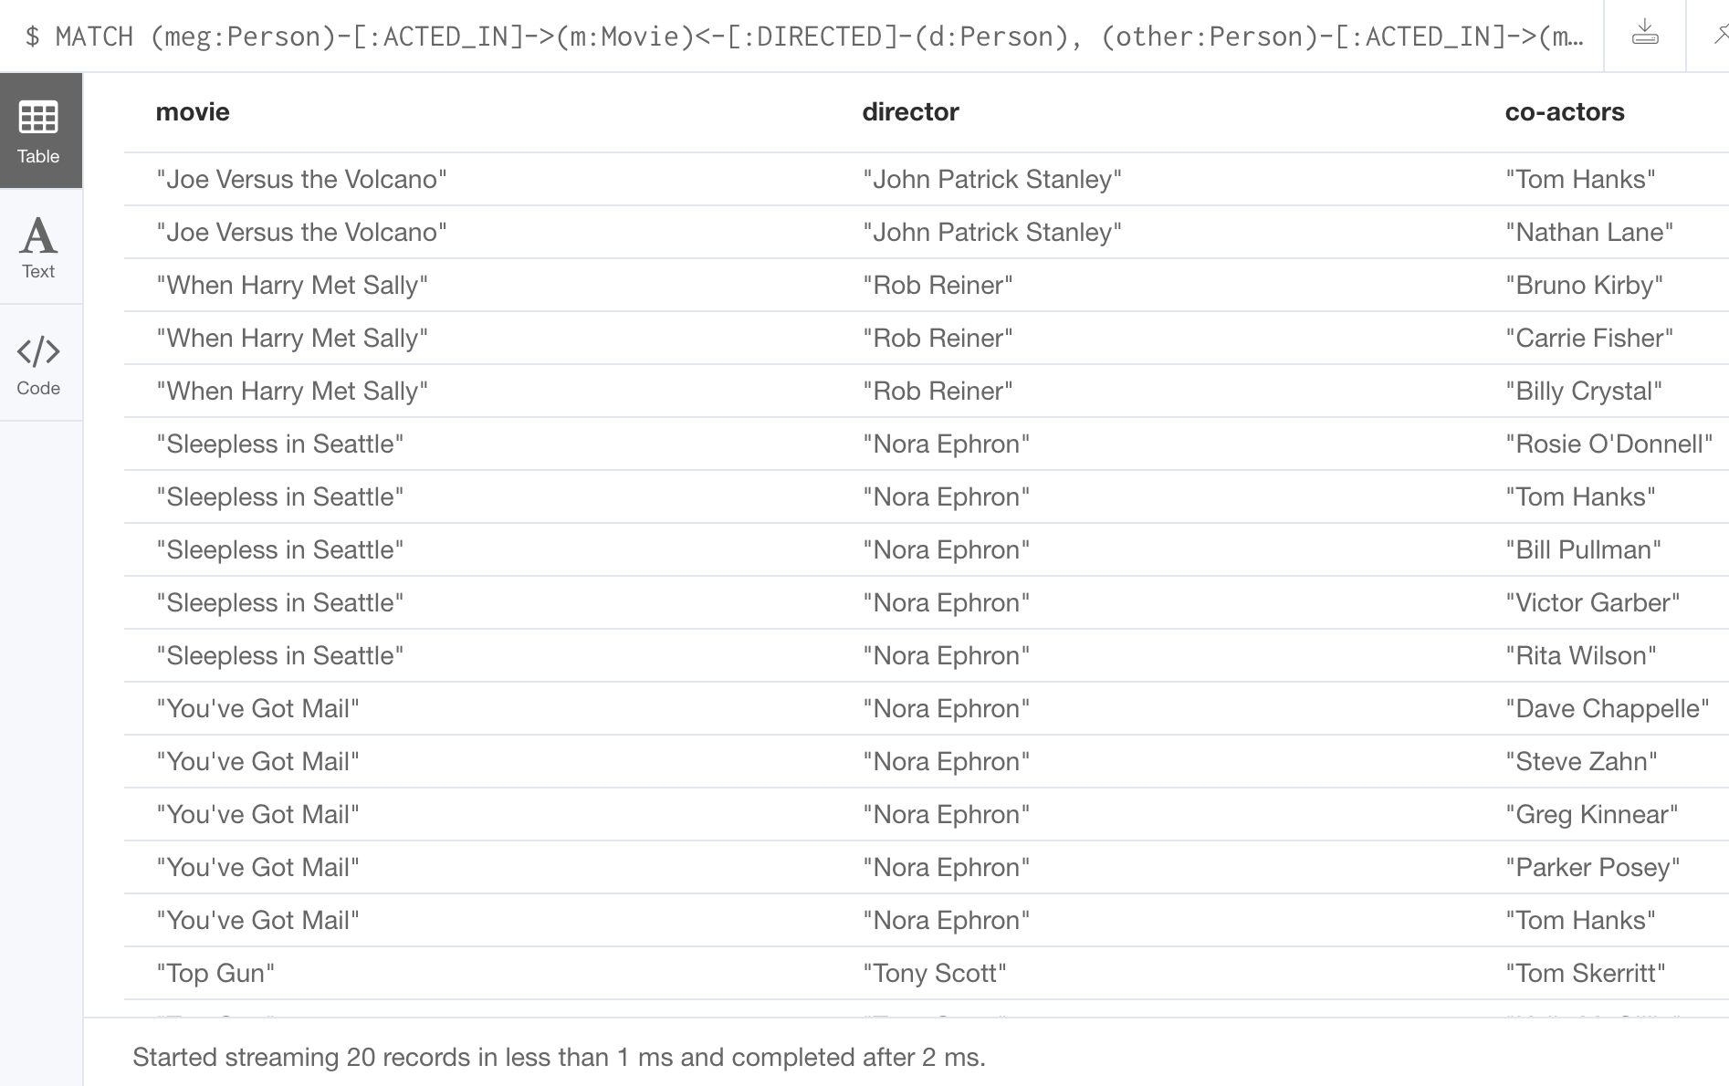
Example 2: Using two MATCH patterns
Retrieve the movies that Meg Ryan acted in and their respective directors, as well as the other actors that acted in these movies:
MATCH (meg:Person)-[:ACTED_IN]->(m:Movie)<-[:DIRECTED]-(d:Person), (other:Person)-[:ACTED_IN]->(m) WHERE meg.name = 'Meg Ryan' RETURN m.title as movie, d.name AS director , other.name AS `co-actors`

Slide 125
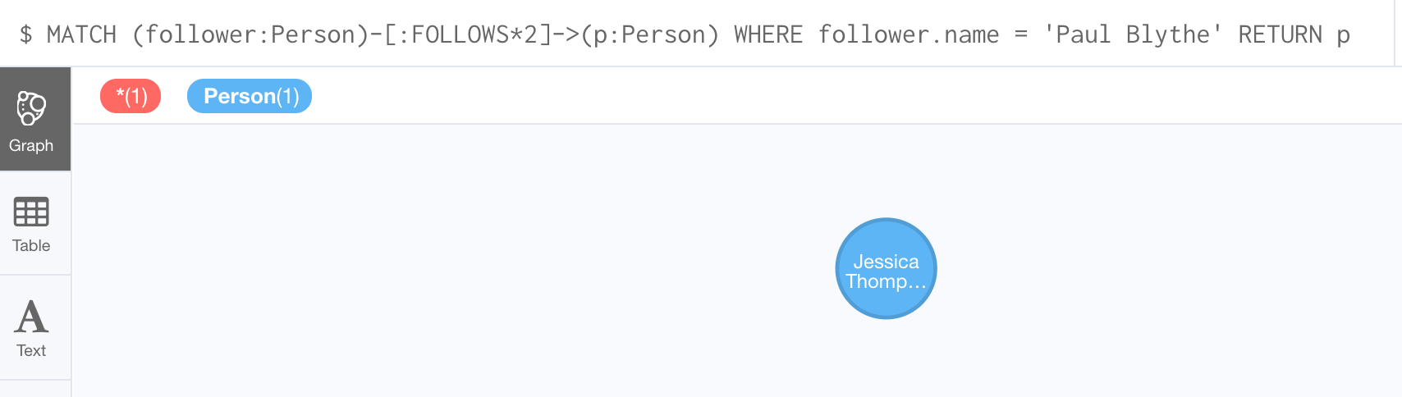
Specifying varying length paths
Find all people who are exactly two hops
away from Paul Blythe:
MATCH (follower:Person)-[:FOLLOWS*2]->(p:Person) WHERE follower.name = 'Paul Blythe' RETURN p

Slide 126

Aggregation in Cypher
Different from SQL - no need to specify a grouping key.
As soon as you use an aggregation function, all non-aggregated result columns automatically become grouping keys.
Implicit grouping based upon fields in the RETURN clause.
// implicitly groups by a.name and d.name
MATCH (a)-[:ACTED_IN]->(m)<-[:DIRECTED]-(d)
RETURN a.name, d.name, count(*)

Slide 127

Collecting results
Find the movies that Tom Cruise acted in and return them
as a list:
MATCH (p:Person)-[:ACTED_IN]->(m:Movie) WHERE p.name ='Tom Cruise' RETURN collect(m.title) AS `movies for Tom Cruise`

Slide 128

Counting results
Find all of the actors and directors who worked on a movie, return the count of the number paths found between actors and directors and collect the movies as a list:
MATCH (actor:Person)-[:ACTED_IN]->(m:Movie)<-[:DIRECTED]-(director:Person) RETURN actor.name, director.name, count(m) AS collaborations,
collect(m.title) AS movies
Notes:
There are more aggregating functions such as `min()` or `max()` that you can also use in your queries. These are described in the Aggregating Functions section of the Developer Manual.

Slide 129
Exercise 5:
Controlling query processing
In Neo4j Browser:
:play intro-exercises
Then follow instructions for Exercise 5.
Notes:
Show students how to :play intro-exercises
and how to navigate to Exercise 5.

Slide 130
Check your understanding

Slide 131
Question 1
Suppose you want to add a WHERE clause at the end of this statement to filter the results retrieved.
MATCH (p:Person)-[rel]->(m:Movie)<-[:PRODUCED]-(:Person)
What variables, can you test in the WHERE clause:
Select the correct answers.
❏ p
❏ rel
❏ m
❏ PRODUCED
Notes:
Suppose you want to add a WHERE clause at the end of this statement to filter the results retrieved.
MATCH (p:Person)-[rel]->(m:Movie)<-[:PRODUCED]-(:Person)
What variables, can you test in the WHERE clause:
Select the correct answers.
✅ p
✅ rel
✅ m
❏ PRODUCED

Slide 132
Answer 1
Suppose you want to add a WHERE clause at the end of this statement to filter the results retrieved.
MATCH (p:Person)-[rel]->(m:Movie)<-[:PRODUCED]-(:Person)
What variables, can you test in the WHERE clause:
Select the correct answers.
✅ p
✅ rel
✅ m
❏ PRODUCED

Slide 133
Question 2
Suppose you want to retrieve all movies that have a released property value that is 2000, 2002, 2004, 2006, or 2008. Here is an incomplete Cypher example to return the title property values of all movies released in these years.
MATCH (m:MovMATCH (m:Movie)
WHERE m.released XX [2000, 2002, 2004, 2006, 2008]
RETURN m.title
What keyword do you specify for XX?
Select the correct answer.
❏ CONTAINS
❏ IN
❏ IS
❏ EQUALS
Notes:
Suppose you want to retrieve all movies that have a released property value that is 2000, 2002, 2004, 2006, or 2008. Here is an incomplete Cypher example to return the title property values of all movies released in these years.
MATCH (m:MovMATCH (m:Movie)
WHERE m.released XX [2000, 2002, 2004, 2006, 2008]
RETURN m.title
What keyword do you specify for XX?
Select the correct answer.
❏ CONTAINS
✅ IN
❏ IS
❏ EQUALS

Slide 134
Answer 2
Suppose you want to retrieve all movies that have a released property value that is 2000, 2002, 2004, 2006, or 2008. Here is an incomplete Cypher example to return the title property values of all movies released in these years.
MATCH (m:MovMATCH (m:Movie)
WHERE m.released XX [2000, 2002, 2004, 2006, 2008]
RETURN m.title
What keyword do you specify for XX?
Select the correct answer.
❏ CONTAINS
✅ IN
❏ IS
❏ EQUALS

Slide 135
Summary
At the end of this module, you should be able to write Cypher statements to:
Filter queries using the WHERE clause
Control query processing
Control what results are returned

Slide 136
Creating Nodes and Relationships

Slide 137
Overview
At the end of this module, you should be able to write Cypher statements to:
Create a node:
Add and remove node labels.
Add and remove node properties.
Update properties.
Create a relationship:
Add and remove properties for a relationship.
Delete a node.
Delete a relationship.
Merge data in a graph:
Creating nodes.
Creating relationships.

Slide 138

Creating a node
Create a node of type Movie with the title property set to Batman Begins:
CREATE (:Movie {title: 'Batman Begins'})
Create a node of type Movie and Action with the title property set to Batman Begins:
CREATE (:Movie:Action {title: 'Batman Begins'})
Create a node of type Movie with the title property set to Batman Begins and return the node:
CREATE (m:Movie {title: 'Batman Begins'})
RETURN m
<id> is set by the graph engine

Slide 139

Creating multiple nodes
Create some Person nodes for actors and the director for the movie, Batman Begins:
CREATE (:Person {name: 'Michael Caine', born: 1933}), (:Person {name: 'Liam Neeson', born: 1952}), (:Person {name: 'Katie Holmes', born: 1978}), (:Person {name: 'Benjamin Melniker', born: 1913})
Important: The graph engine will create a node with the same properties of a node that already exists. You can prevent this from happening in one of two ways: 1. You can use `MERGE` rather than `CREATE` when creating the node. 2. You can add constraints to your graph.
Notes:
You can specify multiple nodes to create separated by commas, or you can specify multiple CREATE statements.
You will learn about MERGE later in this module.
You will learn about constraints in the next module.

Slide 140

Adding a label to a node
Add the Action label to the movie, Batman Begins, return all labels for this node:
MATCH (m:Movie) WHERE m.title = 'Batman Begins' SET m:Action RETURN labels(m)
Notes:
If you add a label to a node that already exists, it is a no-op.

Slide 141

Removing a label from a node
Remove the Action label to the movie, Batman Begins, return all labels for this node:
MATCH (m:Movie:Action) WHERE m.title = 'Batman Begins' REMOVE m:Action RETURN labels(m)

Slide 142

Adding or updating properties for a node
If property does not exist for the node, it is added with the specified value.
If property exists for the node, it is updated with the specified value
Add the properties released and lengthInMinutes to the movie Batman Begins:
MATCH (m:Movie) WHERE m.title = 'Batman Begins' SET m.released = 2005, m.lengthInMinutes = 140 RETURN m

Slide 143

Adding properties to a node - JSON style
Add or update all properties: title, released, lengthInMinutes, videoFormat, and grossMillions for the movie Batman Begins:
MATCH (m:Movie) WHERE m.title = 'Batman Begins' SET m = {title: 'Batman Begins', released: 2005, lengthInMinutes: 140, videoFormat: 'DVD', grossMillions: 206.5} RETURN m
Notes:
Using the JSON style object to set properties, it is all or nothing when you use ‘=’.

Slide 144

Adding or updating properties for a node - JSON style
Add the awards property and update the grossMillions for the movie Batman Begins:
MATCH (m:Movie) WHERE m.title = 'Batman Begins' SET m += { grossMillions: 300, awards: 66} RETURN m
Notes:
Using ‘+=’ is frequently used by most developers.

Slide 145

Removing properties from a node
Properties can be removed in one of two ways:
Set the property value to null
Use the REMOVE keyword
Remove the grossMillions and
videoFormat properties:
MATCH (m:Movie) WHERE m.title = 'Batman Begins' SET m.grossMillions = null REMOVE m.videoFormat RETURN m

Slide 146
Exercise 6:
Creating nodes
In Neo4j Browser:
:play intro-exercises
Then follow instructions for Exercise 6.
Notes:
Show students how to :play intro-exercises
and how to navigate to Exercise 6.

Slide 147

Creating a relationship
You create a relationship by:
Finding the “from node”.
Finding the “to node”.
Using CREATE to add the directed relationship between the nodes.
Create the :ACTED_IN relationship between
the Person, Michael Caine and the Movie,
Batman Begins:
MATCH (a:Person), (m:Movie) WHERE a.name = 'Michael Caine' AND
m.title = 'Batman Begins' CREATE (a)-[:ACTED_IN]->(m) RETURN a, m

Slide 148

Creating multiple relationships
Create the :ACTED_IN relationship
between the Person, Liam Neeson and
the Movie, Batman Begins and the
:PRODUCED relationship between the
Person, Benjamin Melniker and same movie.
MATCH (a:Person), (m:Movie), (p:Person) WHERE a.name = 'Liam Neeson' AND m.title = 'Batman Begins' AND p.name = 'Benjamin Melniker' CREATE (a)-[:ACTED_IN]->(m)<-[:PRODUCED]-(p) RETURN a, m, p
Notes:
Provided you have the “from” and “to” nodes, you can create multiple relationships either is a single pattern or with comma separated patterns.
When you create relationships based upon a `MATCH` clause, you must be certain that only a single node is returned for the `MATCH`, otherwise multiple relationships will be created.
Always use caution to not create multiple relationships of the same type between two nodes (MERGE will help with this!)

Slide 149

Adding properties to relationships
Same technique you use for creating and updating node properties.
Add the roles property to the :ACTED_IN
relationship from Christian Bale to
Batman Begins:
MATCH (a:Person), (m:Movie) WHERE a.name = 'Christian Bale' AND
m.title = 'Batman Begins' AND
NOT exists((a)-[:ACTED_IN]->(m))
CREATE (a)-[rel:ACTED_IN]->(m) SET rel.roles = ['Bruce Wayne','Batman'] RETURN a, m
Notes:
You can check for existence of the relationship before creating it or use MERGE (will learn about later in this module)
You do NOT want duplicate nodes or relationships in your graph!

Slide 150

Removing properties from relationships
Same technique you use for removing node properties.
Remove the roles property from the :ACTED_IN relationship from Christian Bale to Batman Begins:
MATCH (a:Person)-[rel:ACTED_IN]->(m:Movie) WHERE a.name = 'Christian Bale' AND
m.title = 'Batman Begins' REMOVE rel.roles RETURN a, rel, m

Slide 151
Exercise 7:
Creating relationships
In Neo4j Browser:
:play intro-exercises
Then follow instructions for Exercise 7.
Notes:
Show students how to :play intro-exercises
and how to navigate to Exercise 7.

Slide 152


Deleting a relationship
Batman Begins relationships:
Delete the :ACTED_IN relationship between Christian Bale
and Batman Begins:
MATCH (a:Person)-[rel:ACTED_IN]->(m:Movie) WHERE a.name = 'Christian Bale' AND
m.title = 'Batman Begins' DELETE rel RETURN a, m

Slide 153


After deleting the relationship from Christian Bale to Batman Begins
Batman Begins relationships:
Christian Bale relationships:
Notes:
We should not delete Christian Bale because he has a relationship to the movie RescueDawn.

Slide 154

Deleting a relationship and a node - 1
Batman Begins relationships:
Delete the :PRODUCED relationship between Benjamin
Melniker and Batman Begins, as well as the Benjamin
Melniker node:
MATCH (p:Person)-[rel:PRODUCED]->(:Movie) WHERE p.name = 'Benjamin Melniker' DELETE rel, p

Slide 155

Deleting a relationship and a node - 2
Batman Begins relationships:
Attempt to delete Liam Neeson and not his relationships to any
other nodes:
MATCH (p:Person)
WHERE p.name = 'Liam Neeson' DELETE p

Slide 156


Deleting a relationship and a node - 3
Batman Begins relationships:
Delete Liam Neeson and his relationships to any other nodes:
MATCH (p:Person)
WHERE p.name = 'Liam Neeson' DETACH DELETE p

Slide 157
Exercise 8:
Deleting nodes and
relationships
In Neo4j Browser:
:play intro-exercises
Then follow instructions for Exercise 8.
Notes:
Show students how to :play intro-exercises
and how to navigate to Exercise 8.

Slide 158
Merging data in a graph
Create a node with a different label (You do not want to add a label to an existing node.).
Create a node with a different set of properties (You do not want to update a node with existing properties.).
Create a unique relationship between two nodes.
Notes:
Merge is commonly used for:
Loading relational data.
Restructuring the graph for a changed data model.

Slide 159



Using MERGE to create nodes
Current Michael Caine Person node:
Add a Michael Caine Actor node with a value of 1933 for born using MERGE. The Actor node is not found so a new node is created:
MERGE (a:Actor {name: 'Michael Caine'})
SET a.born=1933 RETURN a
Important: Only specify properties that will have unique keys when you merge.
Resulting Michael Caine nodes:
Notes:
We can call MERGE multiple times for the node label Actor, but no new nodes will be created since we have one already in the graph.
Students will learn about unique keys in the next module.

Slide 160
Using MERGE to create relationships
Add the relationship(s) from all Person nodes with a name property that ends with Caine to the Movie node, Batman Begins:
MATCH (p:Person), (m:Movie) WHERE m.title = 'Batman Begins' AND p.name ENDS WITH 'Caine' MERGE (p)-[:ACTED_IN]->(m) RETURN p, m
Notes:
If the MATCH clause returns multiple Person nodes, the graph engine will create multiple relationships, if they don’t already exist.

Slide 161

Specifying creation behavior for the merge
Add a Sir Michael Caine Person node with a born value of 1934 for born using MERGE and also set the birthPlace property:
Current Michael Caine nodes:
MERGE (a:Person {name: 'Sir Michael Caine'}) ON CREATE SET a.born = 1934, a.birthPlace = 'London' RETURN a
Resulting Michael Caine nodes:
Notes:
Because there is no Person node in the graph for Sir Michael Caine, the graph engine creates a new Person node with the property values Sir Michael Caine for the name, 1934 for born, and London for birthPlace.
You need to be careful when merging to ensure that nodes are not created unnecessarily!

Slide 162

Specifying match behavior for the merge
Current Michael Caine nodes:
Add or update the Michael Caine Person node:
MERGE (a:Person {name: 'Sir Michael Caine'})
ON CREATE SET a.born = 1934,
a.birthPlace = 'UK'
ON MATCH SET a.birthPlace = 'UK'
RETURN a
Notes:
You can use MERGE to update existing nodes also. Here we add the Sir Michael Caine node if it doesn’t exist and updates the existing node if it already exists.

Slide 163

Using MERGE to create relationships
Make sure that all Person nodes with a person whose name ends with Caine are connected to the Movie node, Batman Begins.
MATCH (p:Person), (m:Movie) WHERE m.title = 'Batman Begins' AND p.name ENDS WITH 'Caine' MERGE (p)-[:ACTED_IN]->(m) RETURN p, m
Notes:
Using MERGE is a good thing to do when creating relationships to ensure that you do not create multiple relationships in the graph.
This code can run several times and no new relationships will be created.

Slide 164
Exercise 9:
Merging data in the
graph
In Neo4j Browser:
:play intro-exercises
Then follow instructions for Exercise 9.
Notes:
Show students how to :play intro-exercises
and how to navigate to Exercise 9.

Slide 165
Check your understanding

Slide 166
Question 1
What Cypher clauses can you use to create a node?
Select the correct answers.
❏ CREATE
❏ CREATE NODE
❏ MERGE
❏ ADD
Notes:
What Cypher clauses can you use to create a node?
Select the correct answers.
✅ CREATE
❏ CREATE NODE
✅ MERGE
❏ ADD

Slide 167
Answer 1
What Cypher clauses can you use to create a node?
Select the correct answers.
✅ CREATE
❏ CREATE NODE
✅ MERGE
❏ ADD

Slide 168
Question 2
Suppose that you have retrieved a node, s with a property, color:
What Cypher clause do you add here to delete the color property from this node?
Select the correct answers.
❏ DELETE s.color
❏ SET s.color=null
❏ REMOVE s.color
❏ SET s.color=?
Notes:
Suppose that you have retrieved a node,s with a property, color:
What Cypher clause do you add here to delete the color property from this node?
Select the correct answers.
❏ DELETE s.color
✅SET s.color=null
✅ REMOVE s.color
❏ SET s.color=?

Slide 169
Answer 2
Suppose that you have retrieved a node, s with a property, color:
What Cypher clause do you add here to delete the color property from this node?
Select the correct answers.
❏ DELETE s.color
✅ SET s.color=null
✅ REMOVE s.color
❏ SET s.color=?

Slide 170
Question 3
Suppose you retrieve a node, n in the graph that is related to other nodes. What Cypher clause do you write to delete this node and its relationships in the graph?
Select the correct answers.
❏ DELETE n
❏ DELETE n WITH RELATIONSHIPS
❏ REMOVE n
❏ DETACH DELETE n
Notes:
Suppose you retrieve a node, n in the graph that is related to other nodes. What Cypher clause do you write to delete this node and its relationships in the graph?
Select the correct answers.
❏ DELETE n
❏ DELETE n WITH RELATIONSHIPS
❏ REMOVE n
✅ DETACH DELETE n

Slide 171
Answer 3
Suppose you retrieve a node, n in the graph that is related to other nodes. What Cypher clause do you write to delete this node and its relationships in the graph?
Select the correct answers.
❏ DELETE n
❏ DELETE n WITH RELATIONSHIPS
❏ REMOVE n
✅ DETACH DELETE n

Slide 172
Summary
You should be able to write Cypher statements to:
Create a node:
Add and remove node labels.
Add and remove node properties.
Update properties.
Create a relationship:
Add and remove properties for a relationship.
Delete a node.
Delete a relationship.
Merge data in a graph:
Creating nodes.
Creating relationships.

